Slide 1

Understanding Generative Adversarial Networks (GAN)
Group Meeting Discussion
Monday, April 2, 2018

Slide 2
假如你是一名篮球运动员，你想在下次比赛中得到上场机会。
于是在每一次训练赛之后你跟教练进行沟通：
你：教练，我想打球
教练：（评估你的训练赛表现之后）... 算了吧
（你通过跟其他人比较，发现自己的运球很差，于是你苦练了一段时间）
你：教练，我想打球
教练：... 嗯 还不行
（你发现大家投篮都很准，于是你苦练了一段时间的投篮）
你：教练，我想打球
教练： ... 嗯 还有所欠缺
（你发现你的身体不够壮，被人一碰就倒，于是你去泡健身房）
......
通过这样不断的努力和被拒绝，你最终在某一次训练赛之后得到教练的赞赏，获得了上场的机会。
值得一提的是在这个过程中，所有的候选球员都在不断地进步和提升。因而教练也要不断地通过对比场上球员和候补球员来学习分辨哪些球员是真正可以上场的，并且要“观察”得比球员更频繁。随着大家的成长教练也会会变得越来越严格。
一个关于GAN的感性例子
例子来源: 通俗理解生成对抗网络GAN

Slide 3
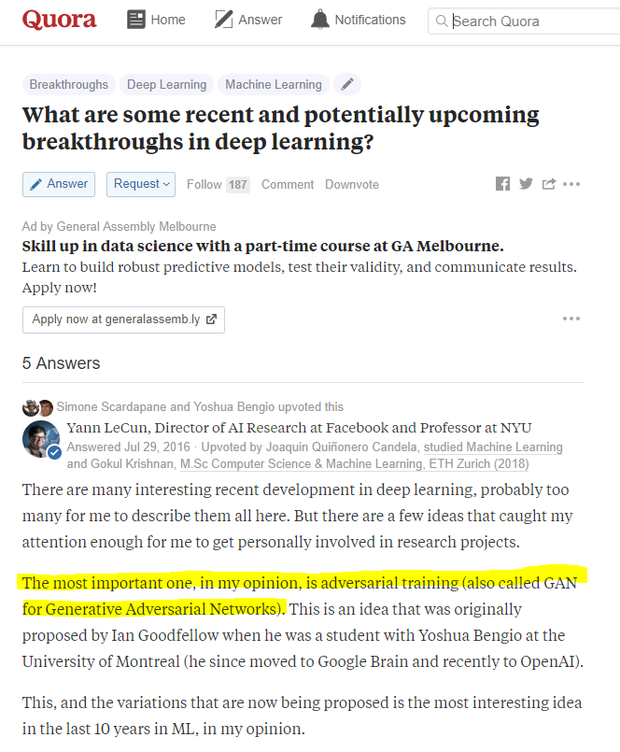
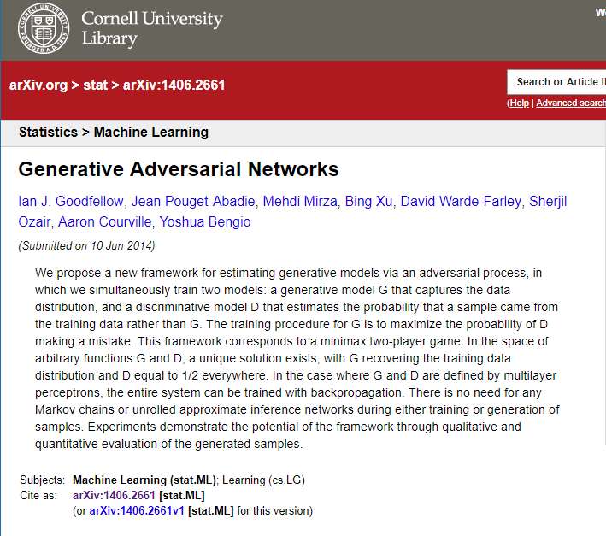
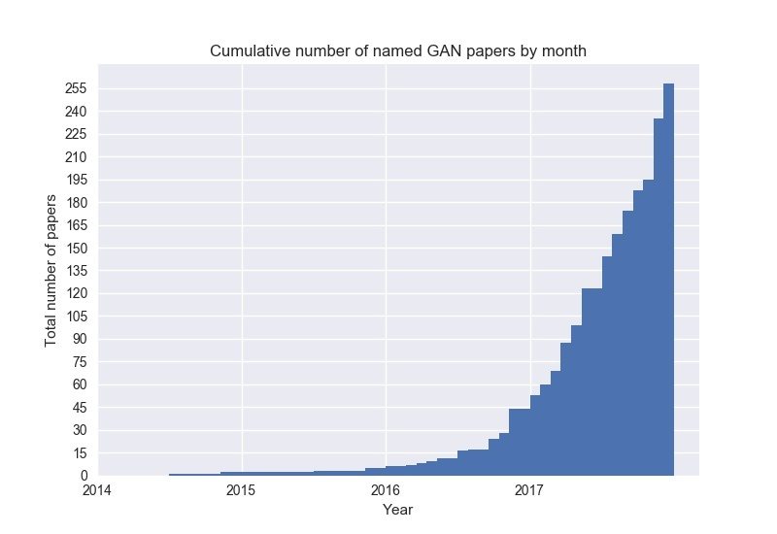
Background
Generative adversarial networks (GANs) are (deep) neural net architectures comprised of two nets, pitting one against the other (thus the “adversarial”).
GANs were introduced in a paper by Ian Goodfellow and other researchers at the University of Montreal, including Yoshua Bengio, in 2014.
Referring to GANs, Facebook’s AI research director Yann LeCun called adversarial training “the most interesting idea in the last 10 years in ML.”
GANs’ potential is huge, because they can learn to mimic any distribution of data. The number of papers about GAN is growing fast.

Slide 4
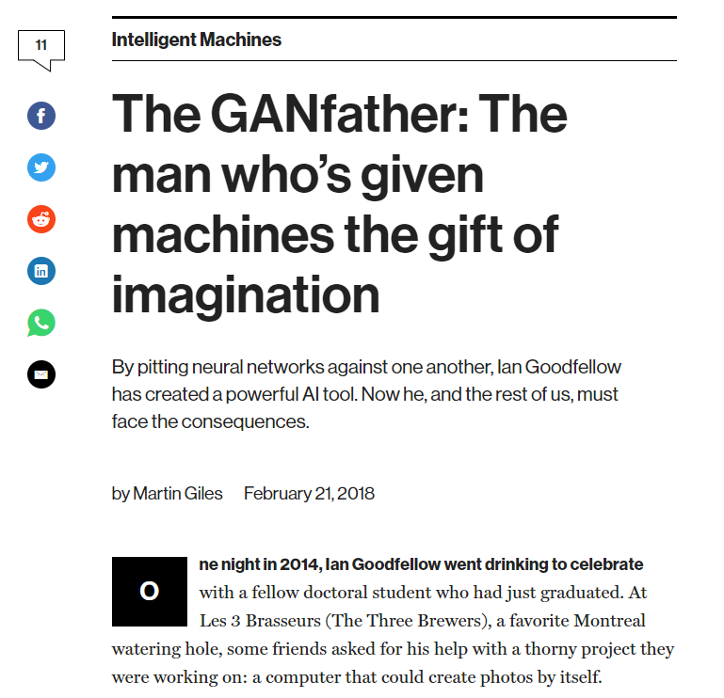

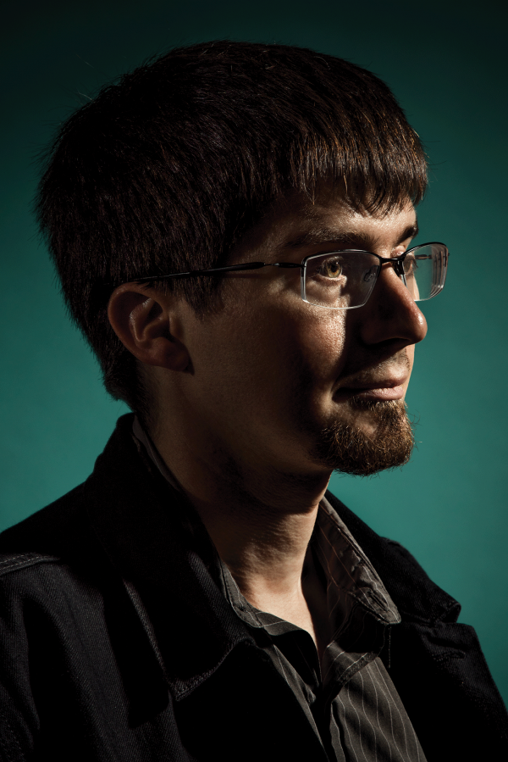
MIT Technology Review: The GANfather: The man who’s given machines the gift of imagination .
Images source from the review

Slide 5
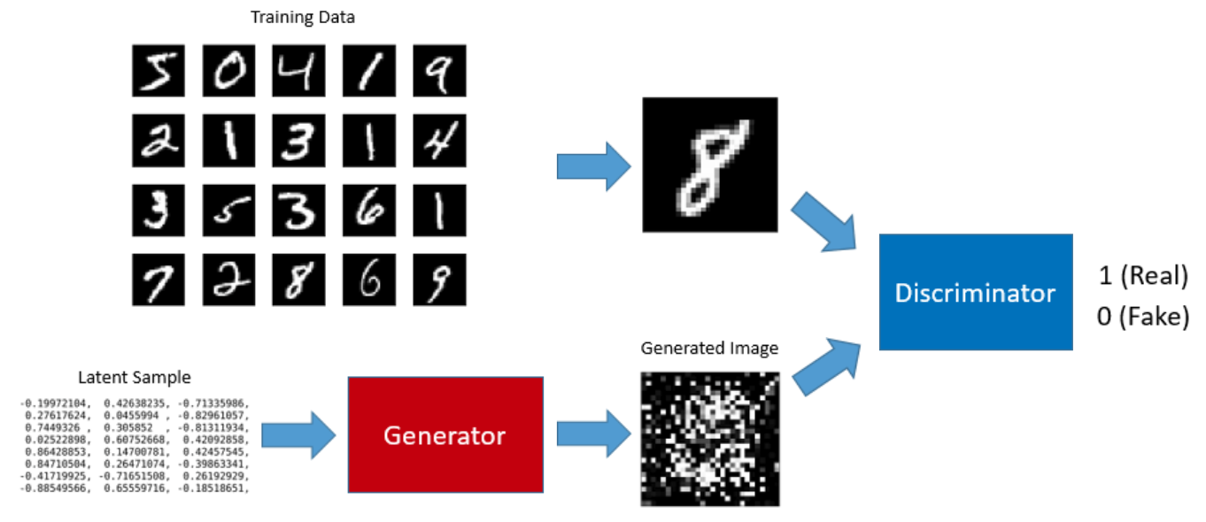
Understanding GAN Framework
A GAN can be trained to generate images from random noises. For example, we can train a GAN to generate digit images that look like hand-written digit images from MNIST database.
A GAN has two parts in it: the generator that generates images and the discriminator that classifies real and fake images.
Image source: Understanding Generative Adversarial Networks.

Slide 6
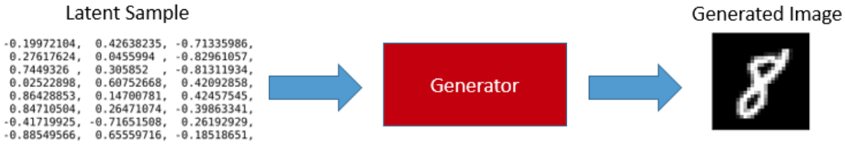
GAN Framework - Generator
The input to the generator is a series of randomly generated numbers called latent sample. Once trained, the generator can produce digit images from latent samples.
Our generator is a simple fully connected network that takes a latent sample (100 randomly generated numbers) and produces 784 data points which can be reshaped into a 28 x 28 digit image which is the size used by all MNIST digit images.
To train the generator, we need to train a GAN. Before talking about GAN, we shall discuss the discriminator.
Image source: Understanding Generative Adversarial Networks.

Slide 7
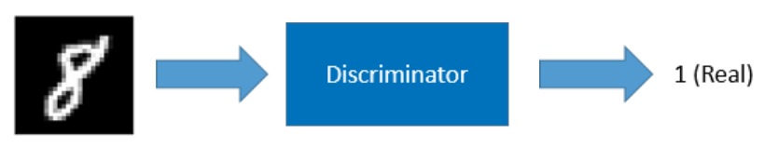
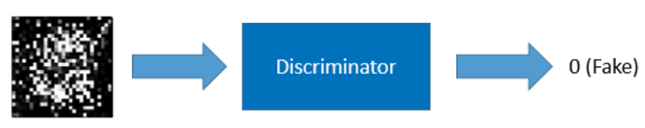
GAN Framework - Discriminator
The discriminator is a classifier trained using the supervised learning. It classifies whether an image is real (1) or not (0).
From MNIST
From Generator
We train the discriminator using both the MNIST images and the images generated by the generator. If the input image is from the MNIST database, the discriminator should classify it as real. If the input image is from the generator, the discriminator should classify it as fake.
Image source: Understanding Generative Adversarial Networks.

Slide 8
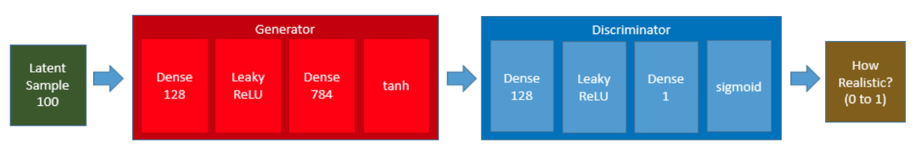
Training the GAN means Training the Generator
We connect the generator and the discriminator to produce a GAN.
When we feed a latent sample to the GAN, the generator internally produces a digit image which is then passed to the discriminator for classification. If the generator does a good job, the discriminator returns a value close to 1 (high probability of the image being real).
We feed latent samples to the GAN while setting the expected outcome (label) to 1 (real) as we expect the generator to produce realistic image, and we expect the discriminator to say it is real or close to real.
However, the generator initially produces garbage images, and the loss value is high. So, the back-propagation updates the generator’s weights to produce more realistic images as the training continues.
Image source: Understanding Generative Adversarial Networks.

Slide 9
How to train a GAN
There is one catch in this process of training the generator via the GAN. We do not want the discriminator’s weights to be affected because we are using the discriminator as merely a classifier.
For this reason, we set the discriminator non-trainable during the generator training.
Image source: Understanding Generative Adversarial Networks.

Slide 10
Training Loop of a GAN
To get a better generator, we also need to train the discriminator as well so that it can do a good job as a classifier of real and fake images. We train the discriminator and the generator in turn in a loop as follows:
Step 1) Set the discriminator trainable;
Step 2) Train the discriminator with the real MNIST digit images and the images generated by the generator to classify the real and fake images.
Step 3) Set the discriminator non-trainable;
Step 4) Train the generator as part of the GAN. We feed latent samples into the GAN and let the generator to produce digit images and use the discriminator to classify the image.
The loop should ideally continue until they are both trained well and can not be improved any further.
1. The Discriminator Training
Image source: Understanding Generative Adversarial Networks.
2. The Generator Training (via GAN)

Slide 11
Training Loop of a GAN
Two different training results
Prepare a batch of real images
Prepare a batch of fake images generated by the generator using latent samples
Make the discriminator trainable
Train the discriminator to classify the real and fake images
Make the discriminator non-trainable
Train the generator via the GAN
Stabilizing GAN
As it turns out, training a GAN is quite hard, and there are many tricks and heuristics required. It is because the discriminator and the generator are not cooperating and individually learning to predict better.
For example, the generator might learn to fool the discriminator with garbage. Ideally, the discriminator should learn earlier than the generator so that it can classify images accurately.
Image source: Understanding Generative Adversarial Networks.

Slide 12
But does it actually work?
The result of the simple GAN is not outstanding. Some of them look pretty good but others are not.
As it turns out, training a GAN requires lots of hacks as per How to Train a GAN? Tips and tricks to make GANs work such as label smoothing and other techniques.
“There are all sorts of empirical quirks. If I train the discriminator much faster than the generator, the generator gives up learning. In some case, the generator learns to deceive the discriminator and makes the discriminator unable to learn to classify properly.”
-- Naoki Shibuya
The results are not outstanding as we are using simple networks. Deep Convolutional GAN (aka DCGAN) would produce better results than this.
Testing results from Generator
Image source: Understanding Generative Adversarial Networks.

Slide 13
The Loss Function of a GAN
G(z): Generator Network
D(x): Discriminator Network
Pdata(x): the distribution of real data;
X: sample from Pdata(x).
P(z): distribution of generator;
Z: sample from Pz(z).
D(x): discriminative distribution
an adversarial pair near convergence.
D is trained to discriminate samples from data.
After an update to G.
After several steps of training.
if G and D have enough capacity, they will reach a point at which both cannot improve.
The discriminator is unable to differentiate between the two distributions, i.e. D(x) = ½.
Image from : https://www.analyticsvidhya.com/blog/2017/06/introductory-generative-adversarial-networks-gans/ ; GAN paper.

Slide 14



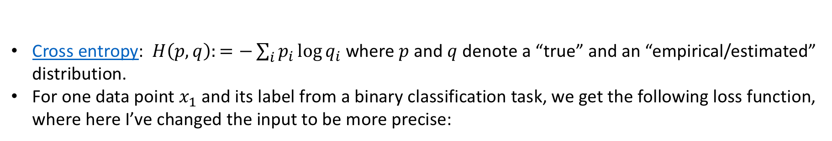
The Loss Function of a GAN
Cross entropy: $H\left(p, q\right):=−\sum_{i}{p_{i}\log{q_{i}}}$ where $p$ and $q$ denote a “true” and an “empirical/estimated” distribution.
For one data point $x_{1}$ and its label from a binary classification task, we get the following loss function, where here I’ve changed the input to be more precise:
One samples:
N samples:
Infinite samples (yi = 1/2):

Slide 15
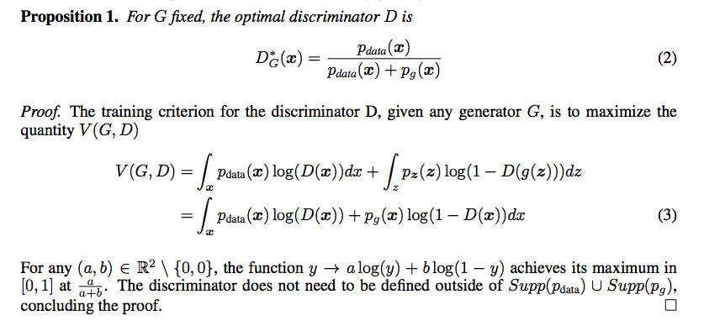
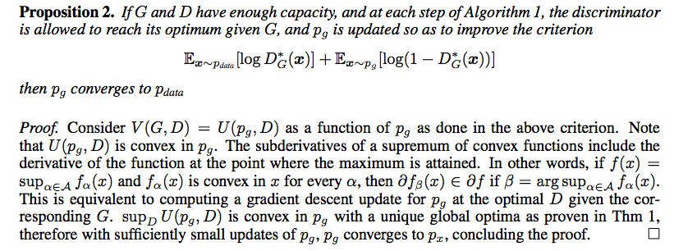
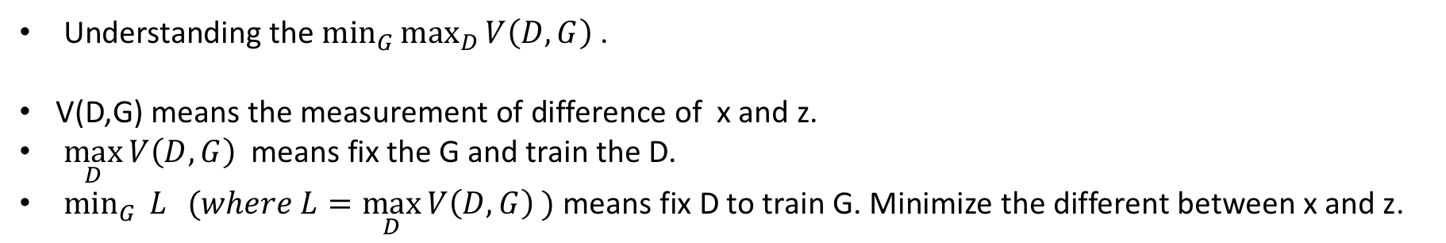
The Loss Function of a GAN (Cont.)
Understanding the $\min_{G}{\max_{D}{V\left(D,G\right) }}$.
V(D,G) means the measurement of difference of x and z.
$\max_{D}{V\left(D, G\right) }$means fix the G and train the D.
$\min_{G}{ L} (where L=\max_{D}{V\left(D, G\right) })$ means fix D to train G. Minimize the different between x and z.

Slide 16
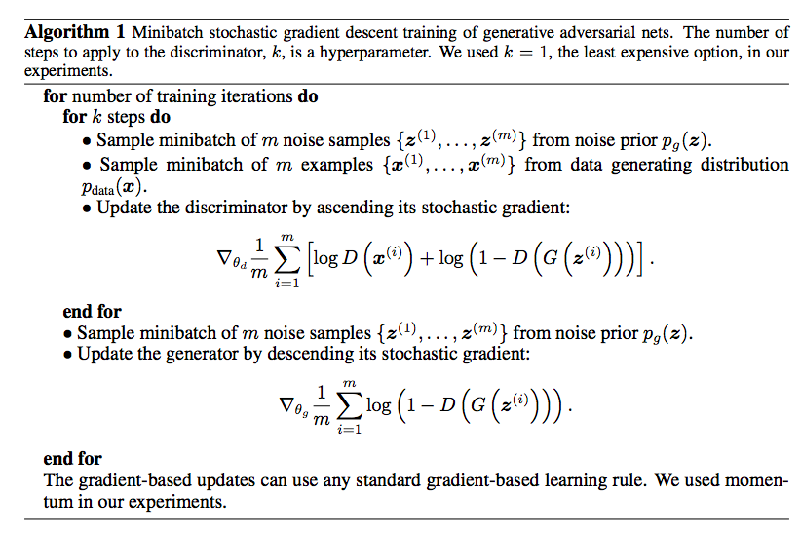
The Training Algorithm (GAN Paper)

Slide 17
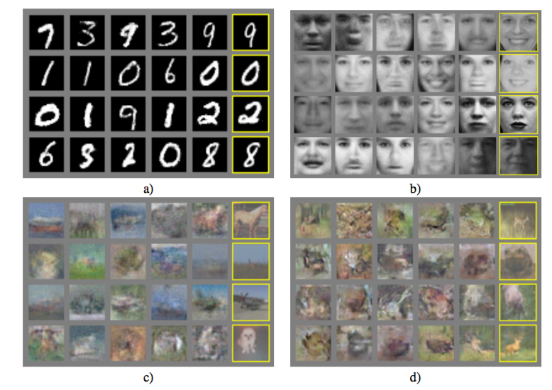

Samples drawn from the generator net after training
Experimental Results from the GAN paper by Ian Goodfellow, etc.
a) MNIST b) TFD c) CIFAR-10 (fully connected model) d) CIFAR-10 (convolutional discriminator and “deconvolutional” generator)
Digits obtained by linearly interpolating between coordinates in z space of the full model.
Images from the GAN paper.

Slide 18
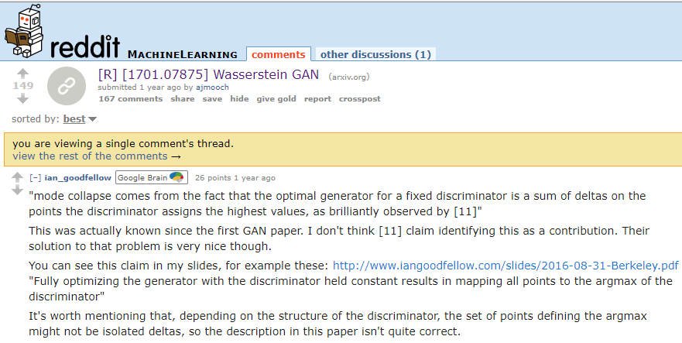
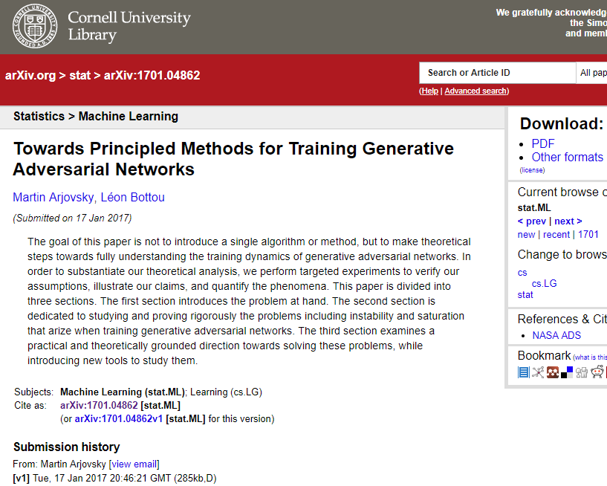
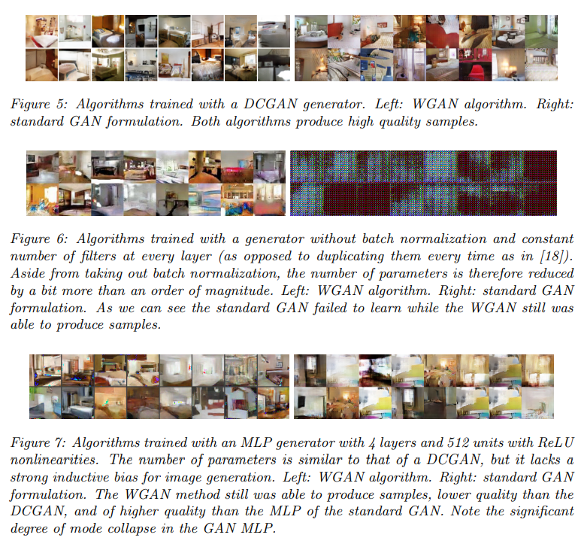
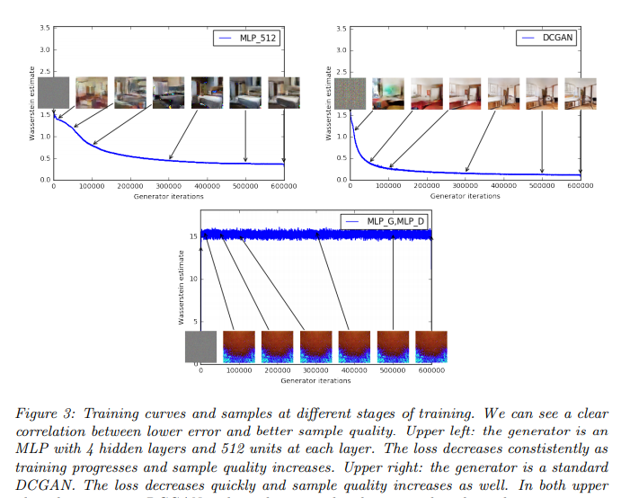
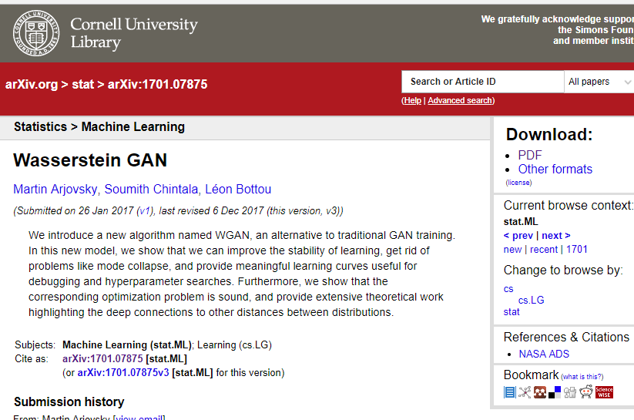
More Research and Application
https://arxiv.org/abs/1701.04862
https://arxiv.org/pdf/1701.07875.pdf

Slide 19
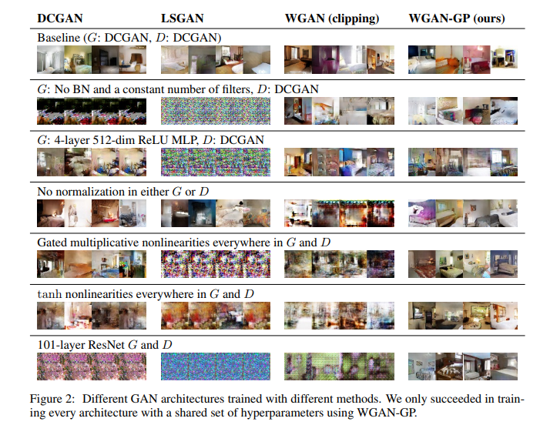
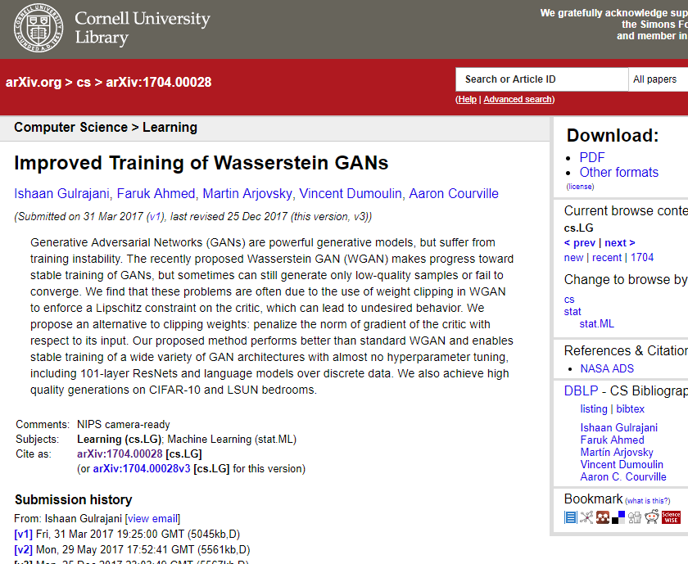
https://arxiv.org/pdf/1704.00028.pdf

Slide 20
GAN ZOO (A-E)
3D-ED-GAN — Shape Inpainting using 3D Generative Adversarial Network and Recurrent Convolutional Networks
3D-GAN — Learning a Probabilistic Latent Space of Object Shapes via 3D Generative-Adversarial Modeling (github)
3D-IWGAN — Improved Adversarial Systems for 3D Object Generation and Reconstruction (github)
3D-RecGAN — 3D Object Reconstruction from a Single Depth View with Adversarial Learning (github)
ABC-GAN — ABC-GAN: Adaptive Blur and Control for improved training stability of Generative Adversarial Networks(github)
ABC-GAN — GANs for LIFE: Generative Adversarial Networks for Likelihood Free Inference
AC-GAN — Conditional Image Synthesis With Auxiliary Classifier GANs
acGAN — Face Aging With Conditional Generative Adversarial Networks
ACtuAL — ACtuAL: Actor-Critic Under Adversarial Learning
AdaGAN — AdaGAN: Boosting Generative Models
AdvGAN — Generating adversarial examples with adversarial networks
AE-GAN — AE-GAN: adversarial eliminating with GAN
AEGAN — Learning Inverse Mapping by Autoencoder based Generative Adversarial Nets
AffGAN — Amortised MAP Inference for Image Super-resolution
AL-CGAN — Learning to Generate Images of Outdoor Scenes from Attributes and Semantic Layouts
ALI — Adversarially Learned Inference
AlignGAN — AlignGAN: Learning to Align Cross-Domain Images with Conditional Generative Adversarial Networks
AM-GAN — Activation Maximization Generative Adversarial Nets
AnoGAN — Unsupervised Anomaly Detection with Generative Adversarial Networks to Guide Marker Discovery
APE-GAN — APE-GAN: Adversarial Perturbation Elimination with GAN
ARAE — Adversarially Regularized Autoencoders for Generating Discrete Structures (github)
ARDA — Adversarial Representation Learning for Domain Adaptation
ARIGAN — ARIGAN: Synthetic Arabidopsis Plants using Generative Adversarial Network
ArtGAN — ArtGAN: Artwork Synthesis with Conditional Categorial GANs
AttGAN — Arbitrary Facial Attribute Editing: Only Change What You Want
AttnGAN — AttnGAN: Fine-Grained Text to Image Generation with Attentional Generative Adversarial Networks
b-GAN — Generative Adversarial Nets from a Density Ratio Estimation Perspective
Bayesian GAN — Deep and Hierarchical Implicit Models (github)
Bayesian GAN — Bayesian GAN
BCGAN — Bayesian Conditional Generative Adverserial Networks
BCGAN — Bidirectional Conditional Generative Adversarial networks
BEGAN — BEGAN: Boundary Equilibrium Generative Adversarial Networks
BGAN — Binary Generative Adversarial Networks for Image Retrieval (github)
BicycleGAN — Toward Multimodal Image-to-Image Translation (github)
BiGAN — Adversarial Feature Learning
BS-GAN — Boundary-Seeking Generative Adversarial Networks
C-GAN — Face Aging with Contextual Generative Adversarial Nets
C-RNN-GAN — C-RNN-GAN: Continuous recurrent neural networks with adversarial training (github)
CA-GAN — Composition-aided Sketch-realistic Portrait Generation
CaloGAN — CaloGAN: Simulating 3D High Energy Particle Showers in Multi-Layer Electromagnetic Calorimeters with Generative Adversarial Networks (github)
CAN — CAN: Creative Adversarial Networks, Generating Art by Learning About Styles and Deviating from Style Norms
CapsuleGAN — CapsuleGAN: Generative Adversarial Capsule Network
CatGAN — Unsupervised and Semi-supervised Learning with Categorical Generative Adversarial Networks
CatGAN — CatGAN: Coupled Adversarial Transfer for Domain Generation
CausalGAN — CausalGAN: Learning Causal Implicit Generative Models with Adversarial Training
CC-GAN — Semi-Supervised Learning with Context-Conditional Generative Adversarial Networks (github)
CDcGAN — Simultaneously Color-Depth Super-Resolution with Conditional Generative Adversarial Network
CFG-GAN — Composite Functional Gradient Learning of Generative Adversarial Models
CGAN — Conditional Generative Adversarial Nets
CGAN — Controllable Generative Adversarial Network
Chekhov GAN — An Online Learning Approach to Generative Adversarial Networks
CipherGAN — Unsupervised Cipher Cracking Using Discrete GANs
CM-GAN — CM-GANs: Cross-modal Generative Adversarial Networks for Common Representation Learning
CoAtt-GAN — Are You Talking to Me? Reasoned Visual Dialog Generation through Adversarial Learning
CoGAN — Coupled Generative Adversarial Networks
ComboGAN — ComboGAN: Unrestrained Scalability for Image Domain Translation (github)
ConceptGAN — Learning Compositional Visual Concepts with Mutual Consistency
Conditional cycleGAN — Conditional CycleGAN for Attribute Guided Face Image Generation
constrast-GAN — Generative Semantic Manipulation with Contrasting GAN
Context-RNN-GAN — Contextual RNN-GANs for Abstract Reasoning Diagram Generation
Coulomb GAN — Coulomb GANs: Provably Optimal Nash Equilibria via Potential Fields
Cover-GAN — Generative Steganography with Kerckhoffs’ Principle based on Generative Adversarial Networks
Cramèr GAN — The Cramer Distance as a Solution to Biased Wasserstein Gradients
Cross-GAN — Crossing Generative Adversarial Networks for Cross-View Person Re-identification
crVAE-GAN — Channel-Recurrent Variational Autoencoders
CS-GAN — Improving Neural Machine Translation with Conditional Sequence Generative Adversarial Nets
CVAE-GAN — CVAE-GAN: Fine-Grained Image Generation through Asymmetric Training
CycleGAN — Unpaired Image-to-Image Translation using Cycle-Consistent Adversarial Networks (github)
D-GAN — Differential Generative Adversarial Networks: Synthesizing Non-linear Facial Variations with Limited Number of Training Data
D2GAN — Dual Discriminator Generative Adversarial Nets
DA-GAN — DA-GAN: Instance-level Image Translation by Deep Attention Generative Adversarial Networks (with Supplementary Materials)
DAGAN — Data Augmentation Generative Adversarial Networks
DAN — Distributional Adversarial Networks
DCGAN — Unsupervised Representation Learning with Deep Convolutional Generative Adversarial Networks (github)
DeblurGAN — DeblurGAN: Blind Motion Deblurring Using Conditional Adversarial Networks (github)
Defense-GAN — Defense-GAN: Protecting Classifiers Against Adversarial Attacks Using Generative Models
DeliGAN — DeLiGAN : Generative Adversarial Networks for Diverse and Limited Data (github)
DF-GAN — Learning Disentangling and Fusing Networks for Face Completion Under Structured Occlusions
DiscoGAN — Learning to Discover Cross-Domain Relations with Generative Adversarial Networks
DistanceGAN — One-Sided Unsupervised Domain Mapping
DM-GAN — Dual Motion GAN for Future-Flow Embedded Video Prediction
DNA-GAN — DNA-GAN: Learning Disentangled Representations from Multi-Attribute Images
dp-GAN — Differentially Private Releasing via Deep Generative Model
DP-GAN — DP-GAN: Diversity-Promoting Generative Adversarial Network for Generating Informative and Diversified Text
DPGAN — Differentially Private Generative Adversarial Network http://arxiv.org/abs/1802.06739 (github)
DR-GAN — Representation Learning by Rotating Your Faces
DRAGAN — How to Train Your DRAGAN (github)
DRPAN — Discriminative Region Proposal Adversarial Networks for High-Quality Image-to-Image Translation
DSP-GAN — Depth Structure Preserving Scene Image Generation
DTN — Unsupervised Cross-Domain Image Generation
DualGAN — DualGAN: Unsupervised Dual Learning for Image-to-Image Translation
Dualing GAN — Dualing GANs
Dynamics Transfer GAN — Dynamics Transfer GAN: Generating Video by Transferring Arbitrary Temporal Dynamics from a Source Video to a Single Target Image
EBGAN — Energy-based Generative Adversarial Network
ecGAN — eCommerceGAN : A Generative Adversarial Network for E-commerce
ED//GAN — Stabilizing Training of Generative Adversarial Networks through Regularization
EGAN — Enhanced Experience Replay Generation for Efficient Reinforcement Learning
EnergyWGAN — Energy-relaxed Wassertein GANs (EnergyWGAN): Towards More Stable and High Resolution Image Generation
ExGAN — Eye In-Painting with Exemplar Generative Adversarial Networks
ExprGAN — ExprGAN: Facial Expression Editing with Controllable Expression Intensity

Slide 21
f-CLSWGAN — Feature Generating Networks for Zero-Shot Learning
f-GAN — f-GAN: Training Generative Neural Samplers using Variational Divergence Minimization
FF-GAN — Towards Large-Pose Face Frontalization in the Wild
FIGAN — Frame Interpolation with Multi-Scale Deep Loss Functions and Generative Adversarial Networks
Fila-GAN — Synthesizing Filamentary Structured Images with GANs
First Order GAN — First Order Generative Adversarial Networks
Fisher GAN — Fisher GAN
Flow-GAN — Flow-GAN: Bridging implicit and prescribed learning in generative models
FSEGAN — Exploring Speech Enhancement with Generative Adversarial Networks for Robust Speech Recognition
FTGAN — Hierarchical Video Generation from Orthogonal Information: Optical Flow and Texture
FusedGAN — Semi-supervised FusedGAN for Conditional Image Generation
FusionGAN — Learning to Fuse Music Genres with Generative Adversarial Dual Learning
G2-GAN — Geometry Guided Adversarial Facial Expression Synthesis
GAGAN — GAGAN: Geometry-Aware Generative Adverserial Networks
GAMN — Generative Adversarial Mapping Networks
GAN — Generative Adversarial Networks (github)
GAN-ATV — A Novel Approach to Artistic Textual Visualization via GAN
GAN-CLS — Generative Adversarial Text to Image Synthesis (github)
GAN-RS — Towards Qualitative Advancement of Underwater Machine Vision with Generative Adversarial Networks
GAN-sep — GANs for Biological Image Synthesis (github)
GAN-VFS — Generative Adversarial Network-based Synthesis of Visible Faces from Polarimetric Thermal Faces
GANCS — Deep Generative Adversarial Networks for Compressed Sensing Automates MRI
GANDI — Guiding the search in continuous state-action spaces by learning an action sampling distribution from off-target samples
GANG — GANGs: Generative Adversarial Network Games
GANosaic — GANosaic: Mosaic Creation with Generative Texture Manifolds
GAP — Context-Aware Generative Adversarial Privacy
GAWWN — Learning What and Where to Draw (github)
GC-GAN — Geometry-Contrastive Generative Adversarial Network for Facial Expression Synthesis
GeneGAN — GeneGAN: Learning Object Transfiguration and Attribute Subspace from Unpaired Data (github)
GeoGAN — Generating Instance Segmentation Annotation by Geometry-guided GAN
Geometric GAN — Geometric GAN
GLCA-GAN — Global and Local Consistent Age Generative Adversarial Networks
GMAN — Generative Multi-Adversarial Networks
GMM-GAN — Towards Understanding the Dynamics of Generative Adversarial Networks
GoGAN — Gang of GANs: Generative Adversarial Networks with Maximum Margin Ranking
GP-GAN — GP-GAN: Towards Realistic High-Resolution Image Blending (github)
GP-GAN — GP-GAN: Gender Preserving GAN for Synthesizing Faces from Landmarks
GPU — A generative adversarial framework for positive-unlabeled classification
GRAN — Generating images with recurrent adversarial networks (github)
GraspGAN — Using Simulation and Domain Adaptation to Improve Efficiency of Deep Robotic Grasping
HAN — Chinese Typeface Transformation with Hierarchical Adversarial Network
HP-GAN — HP-GAN: Probabilistic 3D human motion prediction via GAN
HR-DCGAN — High-Resolution Deep Convolutional Generative Adversarial Networks
IAN — Neural Photo Editing with Introspective Adversarial Networks (github)
IcGAN — Invertible Conditional GANs for image editing (github)
ID-CGAN — Image De-raining Using a Conditional Generative Adversarial Network
IdCycleGAN — Face Translation between Images and Videos using Identity-aware CycleGAN
IFcVAEGAN — Conditional Autoencoders with Adversarial Information Factorization
iGAN — Generative Visual Manipulation on the Natural Image Manifold (github)
Improved GAN — Improved Techniques for Training GANs (github)
In2I — In2I : Unsupervised Multi-Image-to-Image Translation Using Generative Adversarial Networks
InfoGAN — InfoGAN: Interpretable Representation Learning by Information Maximizing Generative Adversarial Nets(github)
IRGAN — IRGAN: A Minimax Game for Unifying Generative and Discriminative Information Retrieval models
Iterative-GAN — Two Birds with One Stone: Iteratively Learn Facial Attributes with GANs (github)
IVE-GAN — IVE-GAN: Invariant Encoding Generative Adversarial Networks
iVGAN — Towards an Understanding of Our World by GANing Videos in the Wild (github)
IWGAN — On Unifying Deep Generative Models
KBGAN — KBGAN: Adversarial Learning for Knowledge Graph Embeddings
KGAN — KGAN: How to Break The Minimax Game in GAN
l-GAN — Representation Learning and Adversarial Generation of 3D Point Clouds
LAC-GAN — Grounded Language Understanding for Manipulation Instructions Using GAN-Based Classification
LAGAN — Learning Particle Physics by Example: Location-Aware Generative Adversarial Networks for Physics Synthesis
LAPGAN — Deep Generative Image Models using a Laplacian Pyramid of Adversarial Networks (github)
LB-GAN — Load Balanced GANs for Multi-view Face Image Synthesis
LD-GAN — Linear Discriminant Generative Adversarial Networks
LDAN — Label Denoising Adversarial Network (LDAN) for Inverse Lighting of Face Images
LeakGAN — Long Text Generation via Adversarial Training with Leaked Information
LeGAN — Likelihood Estimation for Generative Adversarial Networks
LGAN — Global versus Localized Generative Adversarial Nets
LR-GAN — LR-GAN: Layered Recursive Generative Adversarial Networks for Image Generation
LS-GAN — Loss-Sensitive Generative Adversarial Networks on Lipschitz Densities
LSGAN — Least Squares Generative Adversarial Networks
MAD-GAN — Multi-Agent Diverse Generative Adversarial Networks
MAGAN — MAGAN: Margin Adaptation for Generative Adversarial Networks
MalGAN — Generating Adversarial Malware Examples for Black-Box Attacks Based on GAN
MaliGAN — Maximum-Likelihood Augmented Discrete Generative Adversarial Networks
manifold-WGAN — Manifold-valued Image Generation with Wasserstein Adversarial Networks
MARTA-GAN — Deep Unsupervised Representation Learning for Remote Sensing Images
MaskGAN — MaskGAN: Better Text Generation via Filling in the ______
MC-GAN — Multi-Content GAN for Few-Shot Font Style Transfer (github)
McGAN — McGan: Mean and Covariance Feature Matching GAN
MD-GAN — Learning to Generate Time-Lapse Videos Using Multi-Stage Dynamic Generative Adversarial Networks
MDGAN — Mode Regularized Generative Adversarial Networks
MedGAN — Generating Multi-label Discrete Electronic Health Records using Generative Adversarial Networks
MGAN — Precomputed Real-Time Texture Synthesis with Markovian Generative Adversarial Networks (github)
MGGAN — Multi-Generator Generative Adversarial Nets
MIL-GAN — Multimodal Storytelling via Generative Adversarial Imitation Learning
MIX+GAN — Generalization and Equilibrium in Generative Adversarial Nets (GANs)
MLGAN — Metric Learning-based Generative Adversarial Network
MMD-GAN — MMD GAN: Towards Deeper Understanding of Moment Matching Network (github)
MMGAN — MMGAN: Manifold Matching Generative Adversarial Network for Generating Images
MoCoGAN — MoCoGAN: Decomposing Motion and Content for Video Generation (github)
MPM-GAN — Message Passing Multi-Agent GANs
MS-GAN — Temporal Coherency based Criteria for Predicting Video Frames using Deep Multi-stage Generative Adversarial Networks
MuseGAN — MuseGAN: Symbolic-domain Music Generation and Accompaniment with Multi-track Sequential Generative Adversarial Networks
MV-BiGAN — Multi-view Generative Adversarial Networks
OptionGAN — OptionGAN: Learning Joint Reward-Policy Options using Generative Adversarial Inverse Reinforcement Learning
ORGAN — Objective-Reinforced Generative Adversarial Networks (ORGAN) for Sequence Generation Models
ORGAN — 3D Reconstruction of Incomplete Archaeological Objects Using a Generative Adversary Network
PacGAN — PacGAN: The power of two samples in generative adversarial networks
PAN — Perceptual Adversarial Networks for Image-to-Image Transformation
PassGAN — PassGAN: A Deep Learning Approach for Password Guessing
Perceptual GAN — Perceptual Generative Adversarial Networks for Small Object Detection
PGAN — Probabilistic Generative Adversarial Networks
Pip-GAN — Pipeline Generative Adversarial Networks for Facial Images Generation with Multiple Attributes
pix2pix — Image-to-Image Translation with Conditional Adversarial Networks (github)
PixelGAN — PixelGAN Autoencoders
PN-GAN — Pose-Normalized Image Generation for Person Re-identification
Pose-GAN — The Pose Knows: Video Forecasting by Generating Pose Futures
PPGN — Plug & Play Generative Networks: Conditional Iterative Generation of Images in Latent Space
PrGAN — 3D Shape Induction from 2D Views of Multiple Objects
PSGAN — Learning Texture Manifolds with the Periodic Spatial GAN
PS²-GAN — High-Quality Facial Photo-Sketch Synthesis Using Multi-Adversarial Networks
RadialGAN — RadialGAN: Leveraging multiple datasets to improve target-specific predictive models using Generative Adversarial Networks
RAN — RAN4IQA: Restorative Adversarial Nets for No-Reference Image Quality Assessment (github)
RankGAN — Adversarial Ranking for Language Generation
RCGAN — Real-valued (Medical) Time Series Generation with Recurrent Conditional GANs
RefineGAN — Compressed Sensing MRI Reconstruction with Cyclic Loss in Generative Adversarial Networks
RenderGAN — RenderGAN: Generating Realistic Labeled Data
ResGAN — Generative Adversarial Network based on Resnet for Conditional Image Restoration
RNN-WGAN — Language Generation with Recurrent Generative Adversarial Networks without Pre-training (github)
RPGAN — Stabilizing GAN Training with Multiple Random Projections (github)
RTT-GAN — Recurrent Topic-Transition GAN for Visual Paragraph Generation
RWGAN — Relaxed Wasserstein with Applications to GANs
(F-R)

Slide 22
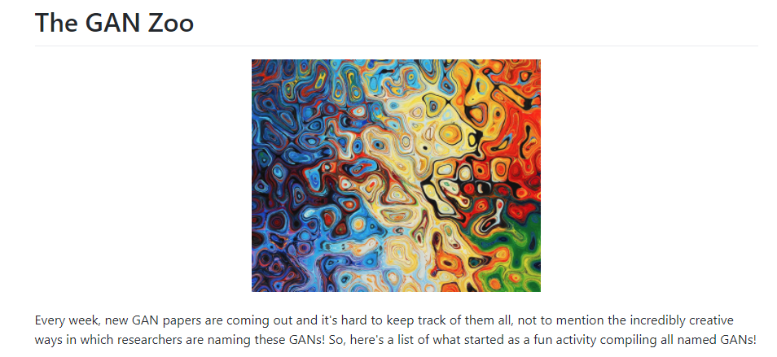
https://github.com/hindupuravinash/the-gan-zoo
SAD-GAN — SAD-GAN: Synthetic Autonomous Driving using Generative Adversarial Networks
SalGAN — SalGAN: Visual Saliency Prediction with Generative Adversarial Networks (github)
SBADA-GAN — From source to target and back: symmetric bi-directional adaptive GAN
SCH-GAN — SCH-GAN: Semi-supervised Cross-modal Hashing by Generative Adversarial Network
SD-GAN — Semantically Decomposing the Latent Spaces of Generative Adversarial Networks
SEGAN — SEGAN: Speech Enhancement Generative Adversarial Network
SeGAN — SeGAN: Segmenting and Generating the Invisible
SegAN — SegAN: Adversarial Network with Multi-scale L1 Loss for Medical Image Segmentation
SeqGAN — SeqGAN: Sequence Generative Adversarial Nets with Policy Gradient (github)
SG-GAN — Semantic-aware Grad-GAN for Virtual-to-Real Urban Scene Adaption (github)
SGAN — Texture Synthesis with Spatial Generative Adversarial Networks
SGAN — Stacked Generative Adversarial Networks (github)
SGAN — Steganographic Generative Adversarial Networks
SGAN — SGAN: An Alternative Training of Generative Adversarial Networks
SimGAN — Learning from Simulated and Unsupervised Images through Adversarial Training
SketchGAN — Adversarial Training For Sketch Retrieval
SketchyGAN — SketchyGAN: Towards Diverse and Realistic Sketch to Image Synthesis
SL-GAN — Semi-Latent GAN: Learning to generate and modify facial images from attributes
SN-GAN — Spectral Normalization for Generative Adversarial Networks (github)
Sobolev GAN — Sobolev GAN
Softmax GAN — Softmax GAN
Splitting GAN — Class-Splitting Generative Adversarial Networks
SRGAN — Photo-Realistic Single Image Super-Resolution Using a Generative Adversarial Network
SRPGAN — SRPGAN: Perceptual Generative Adversarial Network for Single Image Super Resolution
SS-GAN — Semi-supervised Conditional GANs
ss-InfoGAN — Guiding InfoGAN with Semi-Supervision
SSL-GAN — Semi-Supervised Learning with Context-Conditional Generative Adversarial Networks
ST-CGAN — Stacked Conditional Generative Adversarial Networks for Jointly Learning Shadow Detection and Shadow Removal
ST-GAN — Style Transfer Generative Adversarial Networks: Learning to Play Chess Differently
StackGAN — StackGAN: Text to Photo-realistic Image Synthesis with Stacked Generative Adversarial Networks
StarGAN — StarGAN: Unified Generative Adversarial Networks for Multi-Domain Image-to-Image Translation (github)
SteinGAN — Learning Deep Energy Models: Contrastive Divergence vs. Amortized MLE
SVSGAN — SVSGAN: Singing Voice Separation via Generative Adversarial Network
S²GAN — Generative Image Modeling using Style and Structure Adversarial Networks
TAC-GAN — TAC-GAN — Text Conditioned Auxiliary Classifier Generative Adversarial Network (github)
TAN — Outline Colorization through Tandem Adversarial Networks
textGAN — Generating Text via Adversarial Training
TextureGAN — TextureGAN: Controlling Deep Image Synthesis with Texture Patches
TGAN — Temporal Generative Adversarial Nets
TGAN — Tensorizing Generative Adversarial Nets
TGAN — Tensor-Generative Adversarial Network with Two-dimensional Sparse Coding: Application to Real-time Indoor Localization
TP-GAN — Beyond Face Rotation: Global and Local Perception GAN for Photorealistic and Identity Preserving Frontal View Synthesis
Triple-GAN — Triple Generative Adversarial Nets
tripletGAN — TripletGAN: Training Generative Model with Triplet Loss
TV-GAN — TV-GAN: Generative Adversarial Network Based Thermal to Visible Face Recognition
UGACH — Unsupervised Generative Adversarial Cross-modal Hashing
UGAN — Enhancing Underwater Imagery using Generative Adversarial Networks
Unrolled GAN — Unrolled Generative Adversarial Networks (github)
VAE-GAN — Autoencoding beyond pixels using a learned similarity metric
VariGAN — Multi-View Image Generation from a Single-View
VAW-GAN — Voice Conversion from Unaligned Corpora using Variational Autoencoding Wasserstein Generative Adversarial Networks
VEEGAN — VEEGAN: Reducing Mode Collapse in GANs using Implicit Variational Learning (github)
VGAN — Generating Videos with Scene Dynamics (github)
VGAN — Generative Adversarial Networks as Variational Training of Energy Based Models (github)
VGAN — Text Generation Based on Generative Adversarial Nets with Latent Variable
ViGAN — Image Generation and Editing with Variational Info Generative Adversarial Networks
VIGAN — VIGAN: Missing View Imputation with Generative Adversarial Networks
VoiceGAN — Voice Impersonation using Generative Adversarial Networks
VRAL — Variance Regularizing Adversarial Learning
WaterGAN — WaterGAN: Unsupervised Generative Network to Enable Real-time Color Correction of Monocular Underwater Images
WaveGAN — Synthesizing Audio with Generative Adversarial Networks
weGAN — Generative Adversarial Nets for Multiple Text Corpora
WGAN — Wasserstein GAN (github)
WGAN-GP — Improved Training of Wasserstein GANs (github)
WS-GAN — Weakly Supervised Generative Adversarial Networks for 3D Reconstruction
XGAN — XGAN: Unsupervised Image-to-Image Translation for many-to-many Mappings
ZipNet-GAN — ZipNet-GAN: Inferring Fine-grained Mobile Traffic Patterns via a Generative Adversarial Neural Network
α-GAN — Variational Approaches for Auto-Encoding Generative Adversarial Networks (github)
Δ-GAN — Triangle Generative Adversarial Networks
(S-Z)

Slide 23
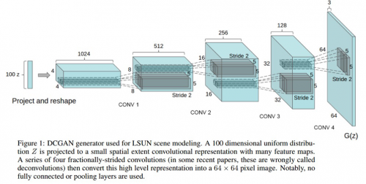
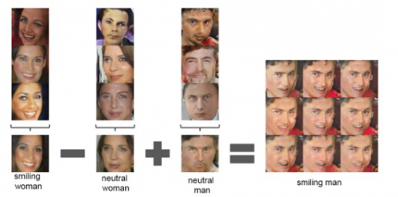
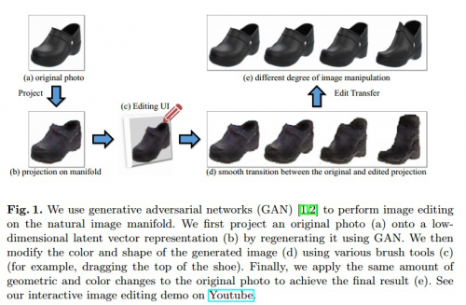
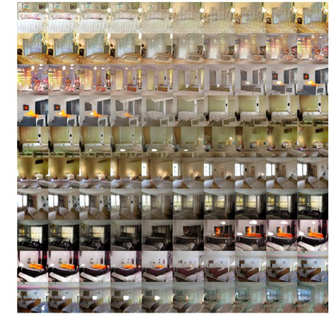
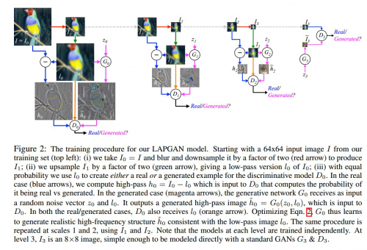
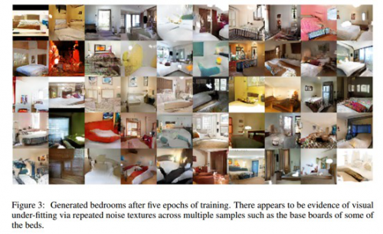
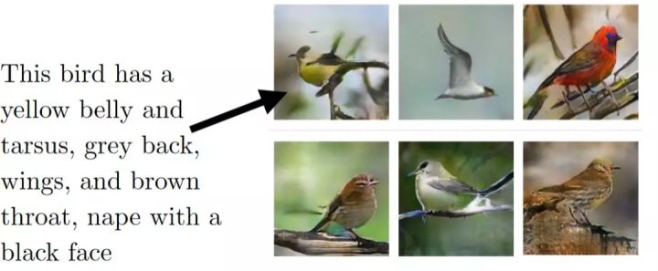

Slide 24
Reference
GAN: A Beginner’s Guide to Generative Adversarial Networks .
Understanding Generative Adversarial Networks.
通俗理解生成对抗网络GAN
Generative Adversarial Nets
Generative Models

