Slide 1
Deep Learning Tutorial
-Draft-
From Perceptrons to Deep Networks
Mr. Caihao Cui
Computer Science and Information Technology
La Trobe University,
Australia 2016

Slide 2



Backgrounds
In recent years, there’s been a resurgence in the field of Artificial Intelligence.
Beyond the academic world, major players like Google, Microsoft, and Facebook are:
  Creating their own research teams.
  Making some impressive acquisitions.

Slide 3
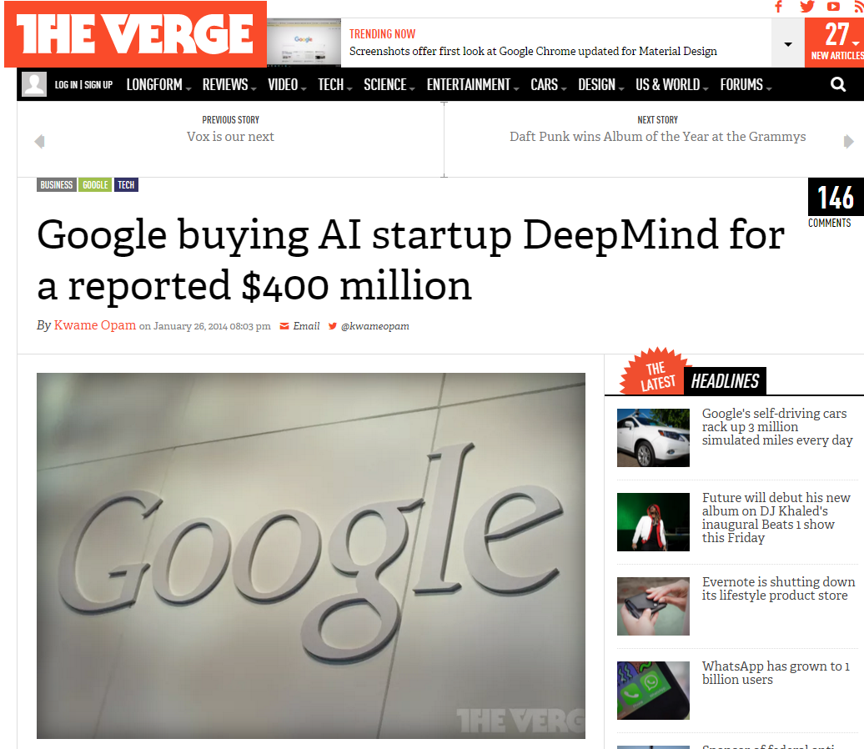

Slide 4
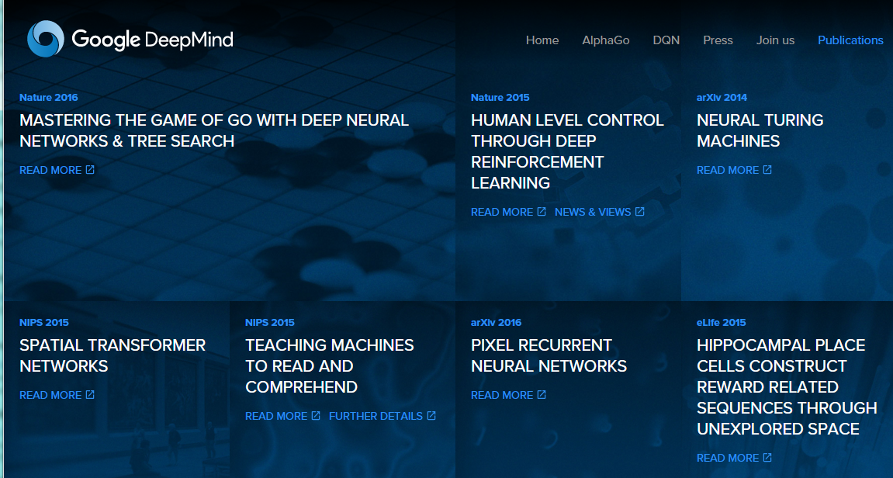
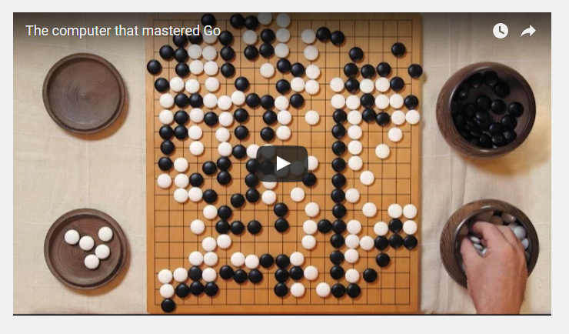
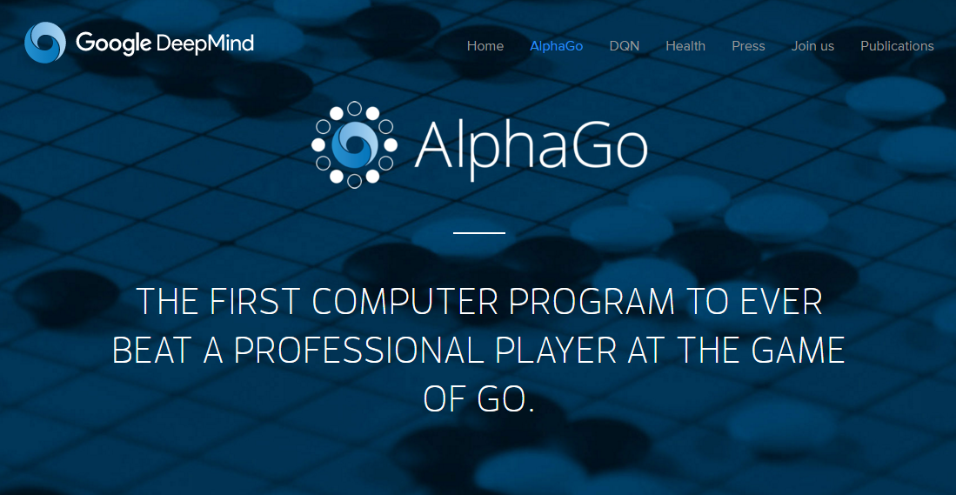

Slide 5
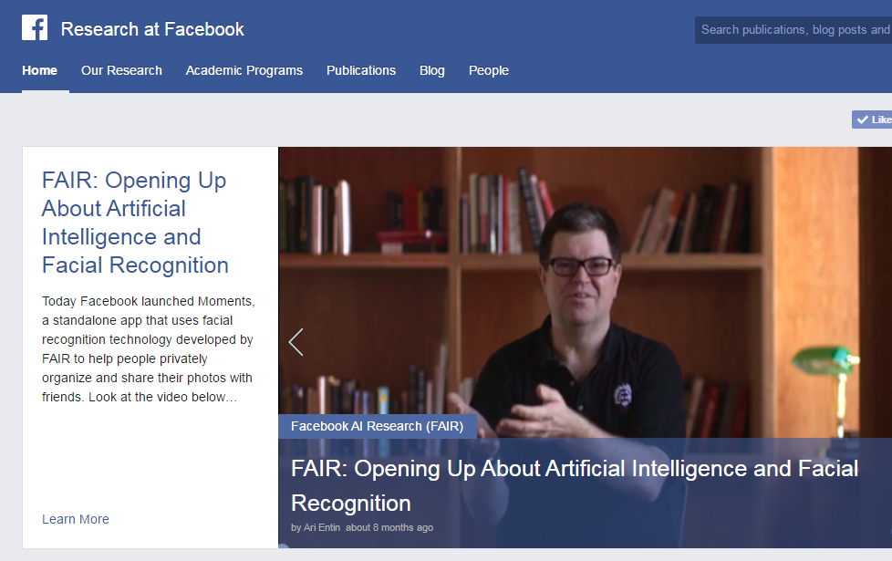

Slide 6


Slide 7

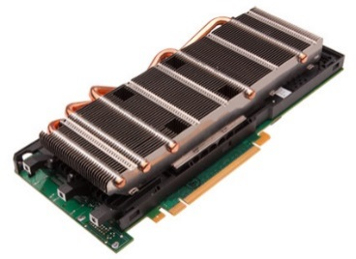
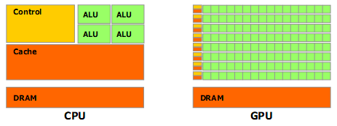
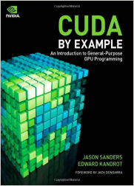
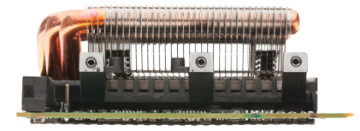
Background (Cont.)
Abundance of social network data.
Cheap computational power available via GPUs.
  GPU：General-purpose computing on graphics processing units.

Slide 8
But beyond these phenomena, this resurgence has been powered in no small part by a new trend in AI, specifically in machine learning, known as
“Deep Learning”.
This tutorial will introduce the key concepts and algorithms behind deep learning, beginning with the simplest unit of composition and leading to the concepts of machine learning.

Slide 9
A Thirty Seconds Tutorial on Machine Learning
Understanding Machine Learning, check out this introduction to machine learning:
The general procedure is as follows:
  1. Assuming there are a handful of labelled samples, say 10 images of dogs with the label 1 (“Dog”) and 10 images of other things with the label 0 (“Not dog”). This is a supervised binary classification task.
  2. Based on some algorithms, the machine “learns” to identify images of dogs. Moreover, when a new image comes, it produces the correct label (0/1).

Slide 10
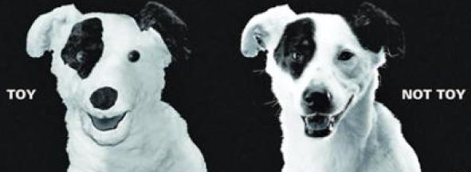
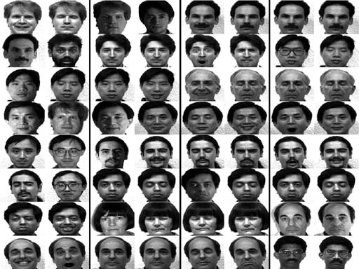
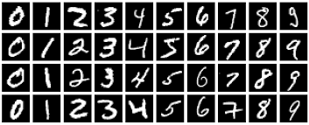
This setting is incredibly general, the samples and labels could be: symptoms and illnesses, images of handwritten characters and actual digits they represent, real people faces and their names.

Slide 11
Perceptrons: Early Deep Learning Algorithms
One of the earliest supervised training model is the perceptron, a basic neural network building unit.
There are n points in the plane, labelled ‘0’ and ‘1’.
Then, here comes a new point without label (this is similar to the “Dog” and “Not dog” scenario above). How to guess that?

Slide 12
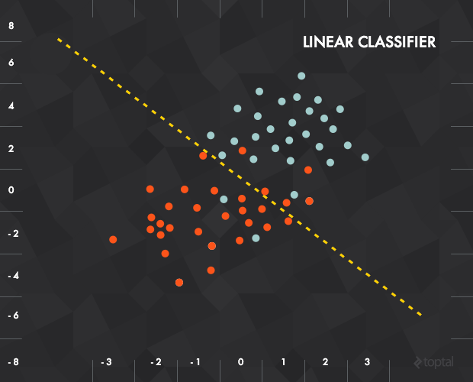
One approach might be to look at the closest neighbour and return that point’s label (k nearest neighbours method).
But a slightly more intelligent way of solving this problem would be to find a line that best separates the labelled data and use that as the linear classifier .

Slide 13
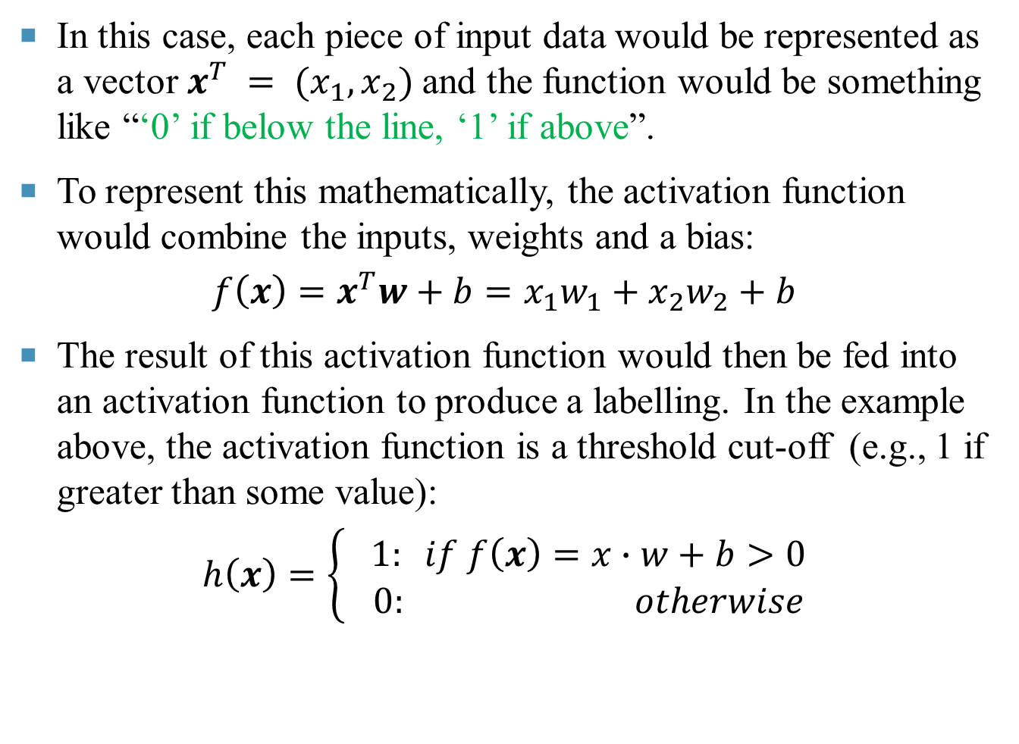
In this case, each piece of input data would be represented as a vector $x^{T} = (x_{1}, x_{2})$and the function would be something like “‘0’ if below the line, ‘1’ if above”.
To represent this mathematically, the activation function would combine the inputs, weights and a bias:
$$f\left(x\right)=x^{T}w+b=x_{1}w_{1}+x_{2}w_{2}+b$$
The result of this activation function would then be fed into an activation function to produce a labelling. In the example above, the activation function is a threshold cut-off (e.g., 1 if greater than some value):
$$h\left(x\right)=\left\{\begin{matrix} 1: if f\left(x\right)=x∙w+b>0 \\ 0: otherwise\end{matrix}\right.$$

Slide 14
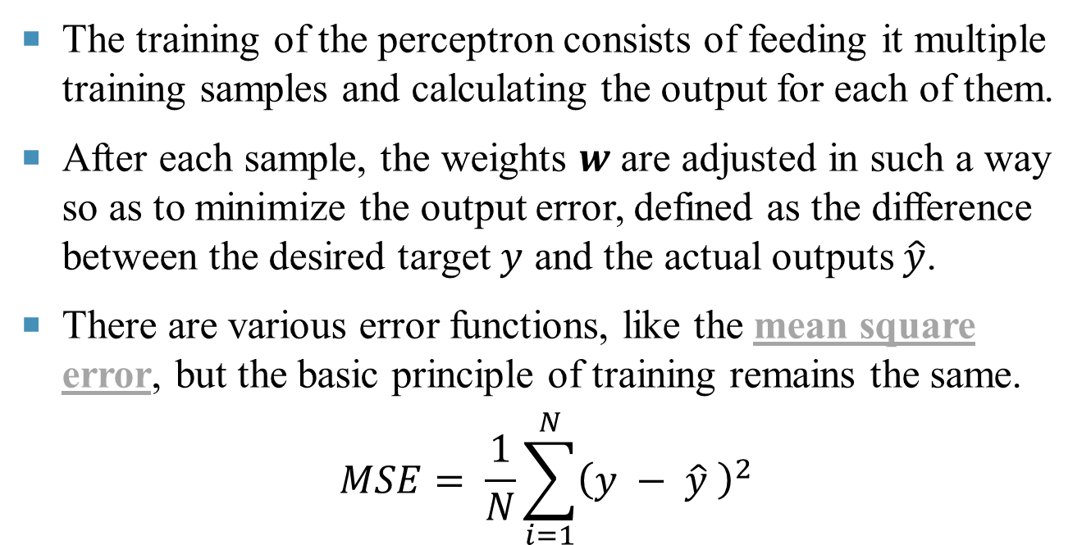
Training the Perceptron
The training of the perceptron consists of feeding it multiple training samples and calculating the output for each of them.
After each sample, the weights $w$ are adjusted in such a way so as to minimize the output error, defined as the difference between the desired target $y$ and the actual outputs $\hat{y}$.
There are various error functions, like the mean square error, but the basic principle of training remains the same.
$$MSE= \frac{1}{N}\sum_{i=1}^{N}{{\left(y − \hat{y} \right)}^{2}}$$

Slide 15
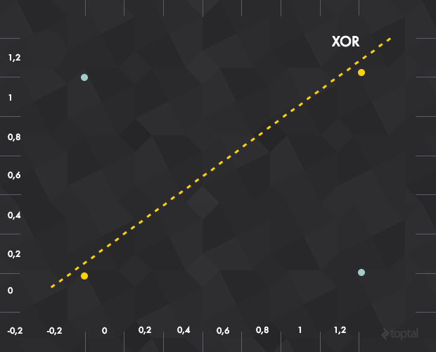
Single Perceptron Drawbacks
The single perceptron approach to deep learning has one major drawback: it can only learn linearly separable functions.
Take XOR, a relatively simple function, and notice that it can’t be classified by a linear separator.
To address this problem, it needs to use a multilayer perceptron, also known as feedforward neural network. In fact, if a bunch of these perceptrons are composed together, they create a more powerful mechanism for learning.

Slide 16
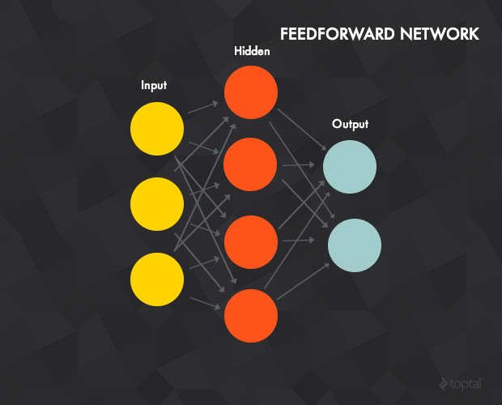
Feedforward Neural Networks for Deep Learning
A neural network is a composition of perceptrons, connected in different ways and operating on different activation functions.

Slide 17
The properties of feedforward neural network
An input, output, and one or more hidden layers. The figure shows a network with a 3-unit input layer, 4-unit hidden layer and an output layer with 2 units (the terms units and neurons are interchangeable).
Each unit is a single perceptron like the one described before.
The units of the input layer serve as inputs for the units of the hidden layer, while the hidden layer units are inputs to the output layer.
Each connection between two neurons has a weight w (similar to the perceptron weights).

Slide 18
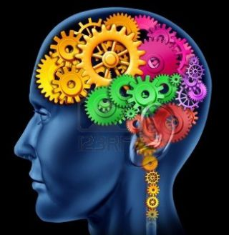
Each unit of layer t is typically connected to every unit of the previous layer t - 1 .
To process input data, the input vector is fed into the input layer. These values are then propagated forward to the hidden units using the activation function for each hidden unit (hence the term forward propagation), which in turn calculate their outputs.
The output layer calculates it’s outputs in the same way as the hidden layer. The result of the output layer is the output of the network.

Slide 19
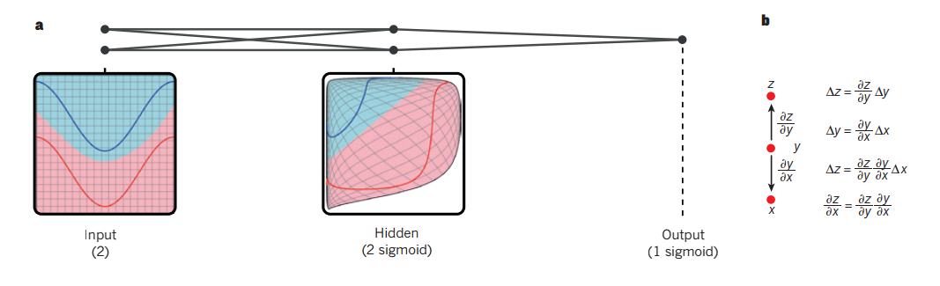
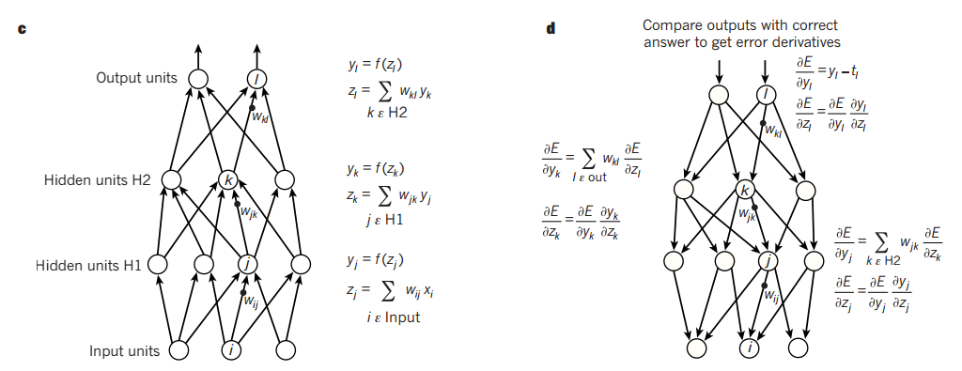
Example: multilayer neural networks and backpropagation.

Slide 20
Beyond Linearity
What if each of the perceptrons is only allowed to use a linear activation function?
Then, the final output of the network will still be some linear function of the inputs, just adjusted with a ton of different weights that it’s collected throughout the network.
In other words, a linear composition of a bunch of linear functions is still just a linear function.
If the network is restricted to linear activation functions, then the feedforward neural network is no more powerful than the perceptron, no matter how many layers it has.

Slide 21
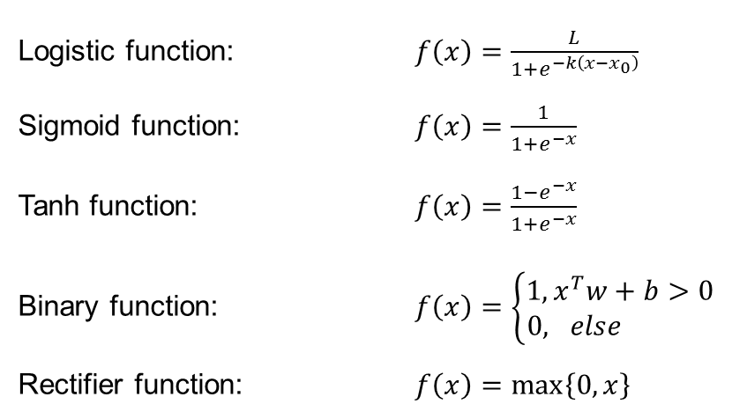
A linear composition of a bunch of linear functions is still just a linear function, so most neural networks use non-linear activation functions.
Because of this, most neural networks use non-linear activation functions like the logistic, tanh, binary or rectifier.
Logistic function: $f\left(x\right)=\frac{L}{1+e^{−k\left(x−x_{0}\right)}}$
Sigmoid function: $f\left(x\right)=\frac{1}{1+e^{−x}}$
Tanh function: $f\left(x\right)=\frac{1−e^{−x}}{1+e^{−x}}$
Binary function: $f\left(x\right)=\left\{\begin{matrix}1, x^{T}w+b>0 \\ 0, else \end{matrix}\right.$
Rectifier function: $f\left(x\right)=\max\left\{0,x\right\}$

Slide 22
Training Perceptrons
The most common deep learning algorithm for supervised training of the multilayer perceptrons is known as backpropagation (BP).
The basic procedure:
A training sample is presented and propagated forward through the network.
The output error is calculated, typically the mean squared error of the target value and the actual network output. Other error calculations are also acceptable, but the MSE is a good choice.

Slide 23
3. Network error is minimized using a method called stochastic gradient descent (SGD).
Gradient descent is universal, but in the case of neural networks, the training error could be seen a function of the input parameters.
The optimal value for each weight is that at which the error achieves a global minimum.
During the training phase, the weights are updated in small steps (after each training sample or a mini-batch of several samples) in such a way that they are always trying to reach the global minimum—but this is no easy task, they often end up in local minima.

Slide 24
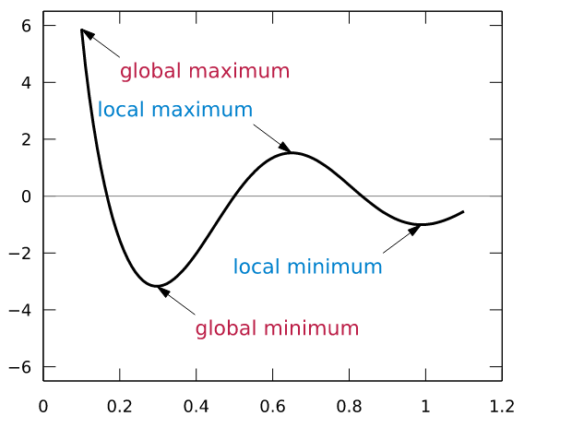
For example, if the weight has a value of 0.6, it needs to be changed towards 0.4.
This figure represents the simplest case, that the error depends on a single parameter.
However, neural network error depends on every network weight and the error function is much, much more complex.

Slide 25
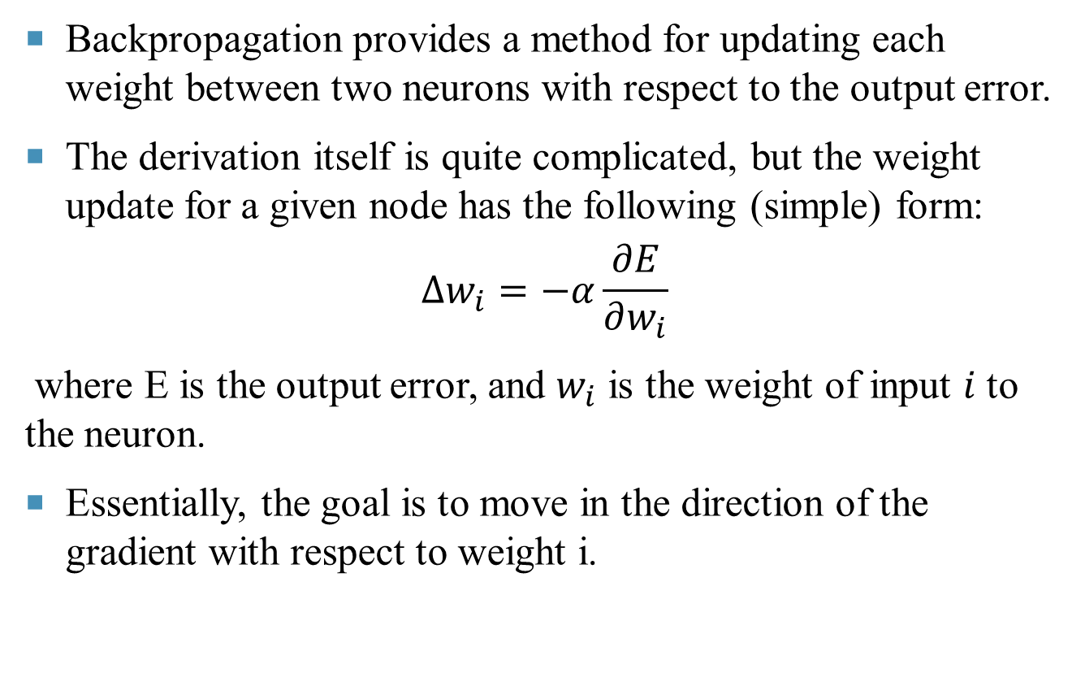
Backpropagation provides a method for updating each weight between two neurons with respect to the output error.
The derivation itself is quite complicated, but the weight update for a given node has the following (simple) form:
$$Δw_{i}=−α\frac{∂E}{∂w_{i}}$$
where E is the output error, and $w_{i}$ is the weight of input $i$ to the neuron.
Essentially, the goal is to move in the direction of the gradient with respect to weight i.

Slide 26
The key term is, the derivative of the error, which isn’t always easy to calculate: how would you find this derivative for a random weight of a random hidden node in the middle of a large network?
The answer: backpropagation (BP).
The errors are first calculated at the output units where the formula is quite simple (based on the difference between the target and predicted values), and then propagated back through the network in a clever fashion, allowing us to efficiently update our weights during training and hopefully reach a minimum.

Slide 27
Hidden Layer
The hidden layer is of particular interest. By the universal approximation theorem, a feedforward network with a single hidden layer containing a finite number of neurons (i.e., a multilayer perceptron), can approximate continuous functions, under mild assumptions on the activation function.
In other words, a single hidden layer is powerful enough to learn most of the functions. That said, the network could learn better in practice with multiple hidden layers (i.e., deeper nets).

Slide 28
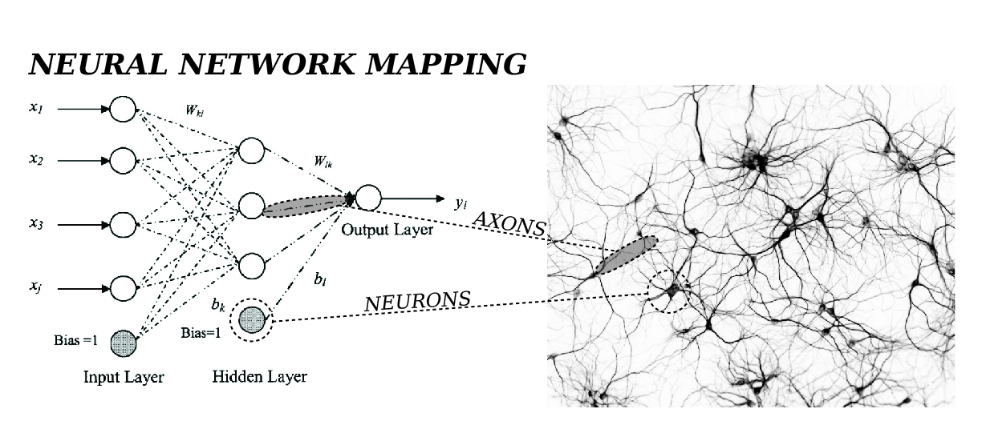
The hidden layer is where the network stores it's internal abstract representation of the training data.
The hidden layer is where the network stores it’s internal abstract representation of the training data, similar to the way that a human brain (greatly simplified analogy) has an internal representation of the real world.

Slide 29
The Problem with Large Networks
A neural network can have more than one hidden layer: in that case, the higher layers are “building” new abstractions on top of previous layers.
However, increasing the number of hidden layers leads to two known issues:
  1. Vanishing gradients: as we add more and more hidden layers, backpropagation becomes less and less useful in passing information to the lower layers.

Slide 30
In effect, as information is passed back, the gradients begin to vanish and become small relative to the weights of the networks.
2. Overfitting: perhaps the central problem in machine learning.
Briefly, overfitting describes the phenomenon of fitting the training data too closely, maybe with hypotheses that are too complex. In such a case, the learner ends up fitting the training data really well, but will perform much, much more poorly on real examples.
The following are some typical deep leaning models and algorithms.

Slide 31
Autoencoders
Most introductory machine learning classes tend to stop with feedforward neural networks. But the space of possible nets is far richer.
An autoencoder is typically a feedforward neural network which aims to learn a compressed, distributed representation (encoding) of a dataset.
An autoencoder neural network is an unsupervised learning model that applies gradient descent or BP, setting the target values to be equal to the inputs.
Here is a example of shallow autoencoder (only one hidden layer).

Slide 32
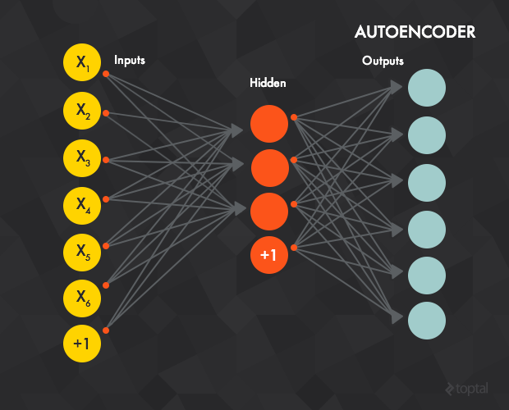
Conceptually, the network is trained to “recreate” the input. The input and the target data are the same.
In other words: the network is trying to output the same thing as input, but compressed in some way. This may be a confusing approach, so here is an example.

Slide 33
Say that the training data consists of 28x28 grayscale images and the value of each pixel is fed to one input layer (i.e., the input layer will have 784 neurons).
Then, the output layer would have the same number of units (784) as the input layer and the target value for each output unit would be the grayscale value of one pixel of the image.
The intuition behind this architecture is that the network will not learn a “mapping” between the training data and its labels (supervised learning ), but will instead learn the internal structure and features of the data itself. (Because of this, the hidden layer is also called feature detector.)

Slide 34
Usually, the number of hidden units is smaller than the input/output layers, which forces the network to learn only the most important features and achieves a dimensionality reduction.
In fact, fewer nodes are preferred in the hidden layer to really learn the data at a conceptual level, producing a compact representation that in some way captures the core features of the input.

Slide 35
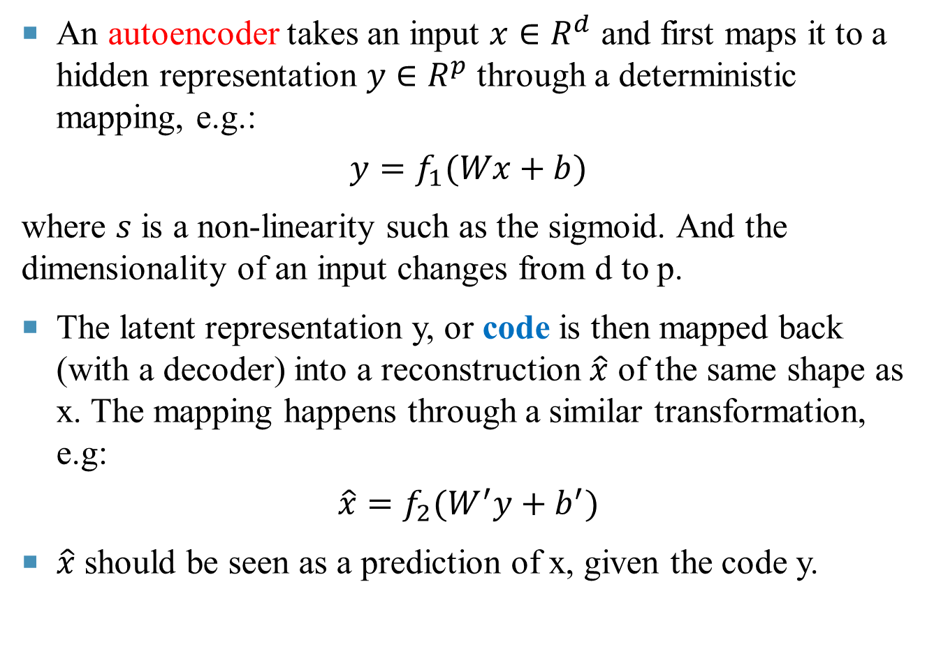
An autoencoder takes an input $x∈R^{d}$ and first maps it to a hidden representation $y∈R^{p}$ through a deterministic mapping, e.g.:
$$y=f_{1}(Wx+b)$$
where $s$ is a non-linearity such as the sigmoid. And the dimensionality of an input changes from d to p.
The latent representation y, or code is then mapped back (with a decoder) into a reconstruction $\hat{x}$ of the same shape as x. The mapping happens through a similar transformation, e.g:
$$\hat{x}=f_{2}(W^{′}y+b^{′})$$
$\hat{x}$ should be seen as a prediction of x, given the code y.

Slide 36
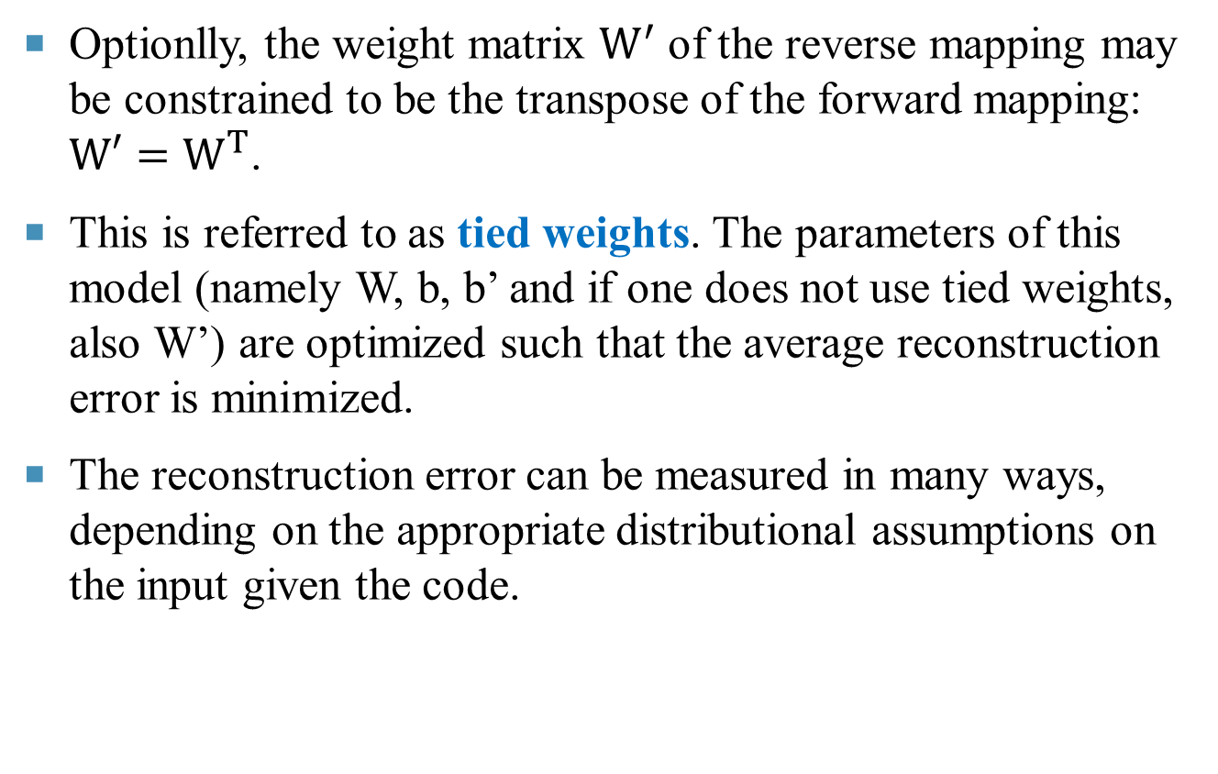
Optionlly, the weight matrix $W^{′}$ of the reverse mapping may be constrained to be the transpose of the forward mapping: $W′=W^{T}$.
This is referred to as tied weights. The parameters of this model (namely W, b, b’ and if one does not use tied weights, also W’) are optimized such that the average reconstruction error is minimized.
The reconstruction error can be measured in many ways, depending on the appropriate distributional assumptions on the input given the code.

Slide 37

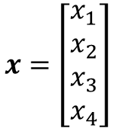





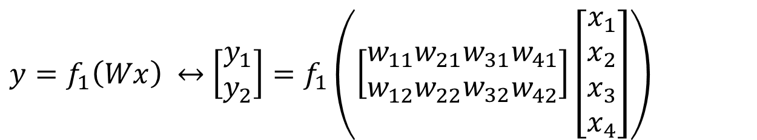









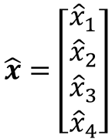
Example: Autoencoder ( Tied Weights )
$$x_{1}$$
$$W$$
$$W^{′}$$
$${\hat{x}}_{1}$$
$$w_{11}$$
$$x_{2}$$
$$w_{12}$$
$$y_{1}$$
$${\hat{x}}_{2}$$
$$x=\left[\begin{aligned}x_{1} \\ x_{2} \\ x_{3} \\ x_{4}\end{aligned}\right]$$
$$\hat{x}=\left[\begin{aligned}{\hat{x}}_{1} \\ {\hat{x}}_{2} \\ {\hat{x}}_{3} \\ {\hat{x}}_{4}\end{aligned}\right]$$
$$x_{3}$$
$$y_{2}$$
$${\hat{x}}_{3}$$
$$x_{4}$$
$$y=\left[\begin{aligned}y_{1} \\ y_{2}\end{aligned}\right]$$
$${\hat{x}}_{4}$$
Hidden layer output:
$y=f_{1}\left(Wx\right) ↔$ $\left[\begin{aligned}y_{1} \\ y_{2}\end{aligned}\right]=f_{1}\left(\left[\begin{matrix}w_{11} \\ w_{12}\end{matrix}\begin{matrix}w_{21} \\ w_{22}\end{matrix}\begin{matrix}w_{31} \\ w_{32}\end{matrix}\begin{matrix}w_{41} \\ w_{42}\end{matrix}\right]\left[\begin{aligned}x_{1} \\ x_{2} \\ x_{3} \\ x_{4}\end{aligned}\right]\right)$

Slide 38

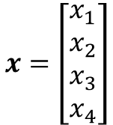





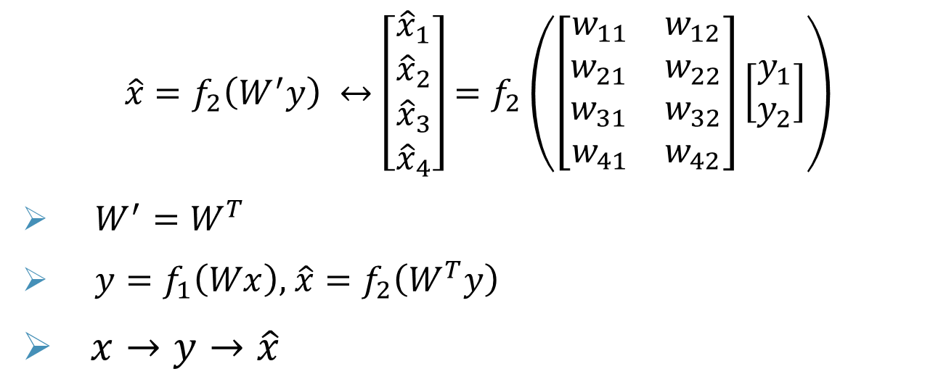









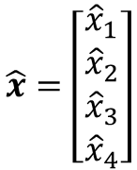
$$x_{1}$$
$$W$$
$$W^{′}$$
$${\hat{x}}_{1}$$
$$w_{11}$$
$$w_{12}$$
$$x=\left[\begin{aligned}x_{1} \\ x_{2} \\ x_{3} \\ x_{4}\end{aligned}\right]$$
$$x_{2}$$
$$y_{1}$$
$${\hat{x}}_{2}$$
$$\hat{x}=\left[\begin{aligned}{\hat{x}}_{1} \\ {\hat{x}}_{2} \\ {\hat{x}}_{3} \\ {\hat{x}}_{4}\end{aligned}\right]$$
$$x_{3}$$
$$y_{2}$$
$${\hat{x}}_{3}$$
$$x_{4}$$
$$y=\left[\begin{aligned}y_{1} \\ y_{2}\end{aligned}\right]$$
$${\hat{x}}_{4}$$
Output layer :
$$\hat{x}=f_{2}\left(W^{′}y\right) ↔\left[\begin{aligned}{\hat{x}}_{1} \\ {\hat{x}}_{2} \\ {\hat{x}}_{3} \\ {\hat{x}}_{4}\end{aligned}\right]=f_{2}\left(\left[\begin{aligned}\begin{matrix}w_{11} & w_{12}\end{matrix} \\ \begin{matrix}w_{21} & w_{22}\end{matrix} \\ \begin{matrix}w_{31} & w_{32}\end{matrix} \\ \begin{matrix}w_{41} & w_{42}\end{matrix}\end{aligned}\right]\left[\begin{aligned}y_{1} \\ y_{2}\end{aligned}\right]\right)$$
$W^{′}=W^{T}$
$y=f_{1}\left(Wx\right),$ $\hat{x}=f_{2}\left(W^{T}y\right)$
$x→y→\hat{x}$

Slide 39
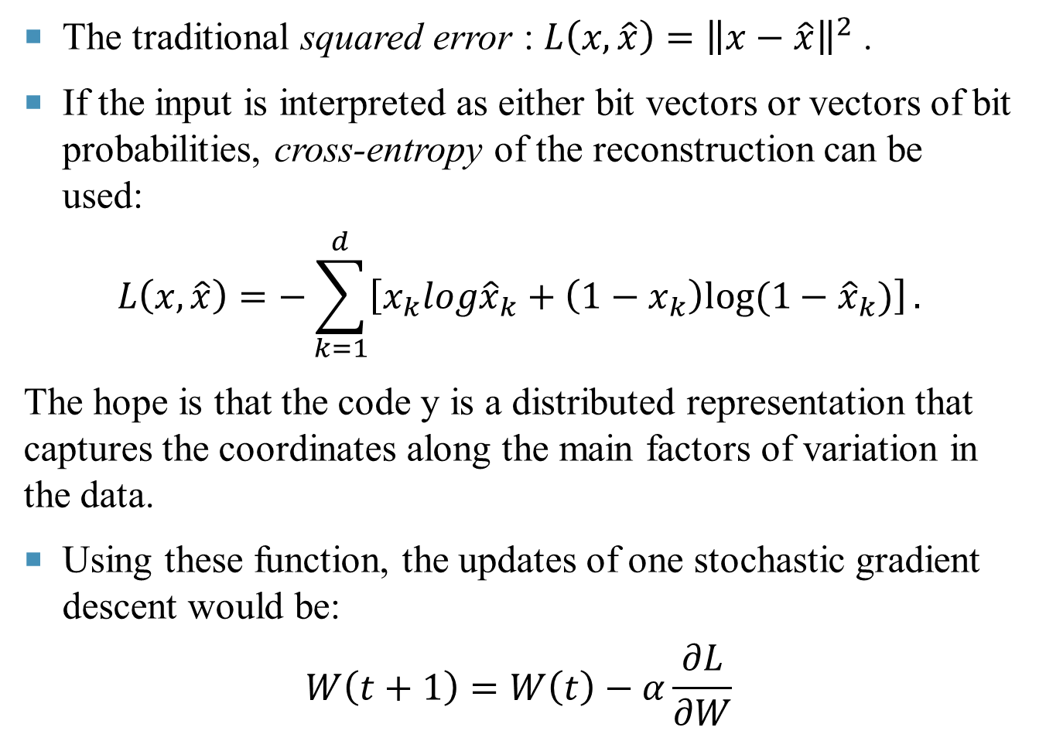
The traditional squared error : $L\left(x,\hat{x}\right)={\left\|x−\hat{x}\right\|}^{2}$ .
If the input is interpreted as either bit vectors or vectors of bit probabilities, cross-entropy of the reconstruction can be used:
$$L\left(x,\hat{x}\right)=−\sum_{k=1}^{d}{\left[x_{k}log{\hat{x}}_{k}+\left(1−x_{k}\right)log⁡(1−{\hat{x}}_{k})\right]}.$$
The hope is that the code y is a distributed representation that captures the coordinates along the main factors of variation in the data.
Using these function, the updates of one stochastic gradient descent would be:
$$W\left(t+1\right)=W\left(t\right)−α\frac{∂L}{∂W}$$

Slide 40
By limiting the number of hidden units, autoencoder can discover interesting structure about the data. If some of the input features are correlated, then this algorithm will be able to discover some correlations.
In fact, this simple autoencoder often ends up learning a low-dimensional representation very similar to PCAs.
Surprisingly, experiments suggest that, in practice, when trained with stochastic gradient descent (SGD), non-linear autoencoders with more hidden units than inputs (called overcomplete) yield useful representations.

Slide 41
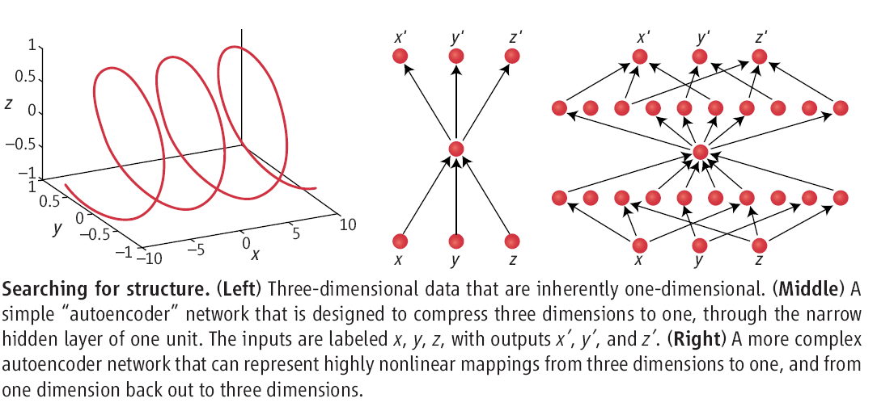
Here, “useful” means that a network taking the encoding as input has low classification error.
A simple explanation is that stochastic gradient descent with early stopping is similar to an L2 regularization of the parameters. hidden units (exactly like in the above code) needs very small weights in the first (encoding) layer, to bring the non-linearity of the hidden units into their linear regime, and very large weights in the second (decoding) layer.

Slide 42
To achieve perfect reconstruction of continuous inputs, a one-hidden layer auto-encoder with non-linear units needs very small weights in the first (encoding) layer, to bring the non-linearity of the hidden units into their linear regime, and very large weights in the second (decoding) layer.
With binary inputs, very large weights are also needed to completely minimize the reconstruction error.
There are other ways by which an auto-encoder with more hidden units than inputs could be prevented from learning the identity function, capturing something useful about the input in its hidden representation.
One is the addition of sparsity (forcing many of the hidden units to be zero or near-zero).

Slide 43
Another is to add randomness in the transformation from input to reconstruction. This technique is used in Restricted Boltzmann Machines (RBM), as well as in Denoising Autoencoders.
The idea behind denoising autoencoders is simple. In order to force the hidden layer to discover more robust features and prevent it from simply learning the identity, the autoencoder is trained to reconstruct the input from a corrupted version of it.
The stochastic corruption process randomly sets some of the inputs (as many as half of them) to zero. Hence the denoising autoencoder is trying to predict the corrupted (i.e. missing) values from the uncorrupted (i.e., non-missing) values, for randomly selected subsets of missing patterns.

Slide 44
Flu Illness
To further demonstrate autoencoders, let’s look at one more application. Use a simple dataset consisting of flu symptoms. Here’s how the data set breaks down:
There are six binary input features.
The first three are symptoms of the illness.
For example, 1 0 0 0 0 0 indicates that this patient has a high temperature, while 0 1 0 0 0 0 indicates coughing, 1 1 0 0 0 0 indicates coughing and high temperature, etc.
The final three features are “counter” symptoms; when a patient has one of these, it’s less likely that he or she is sick.
For example, 0 0 0 1 0 0 indicates that this patient has a flu vaccine. It’s possible to have combinations of the two sets of features: 0 1 0 1 0 0 indicates a vaccines patient with a cough.

Slide 45
Consider a patient is sick when he or she has at least two of the first three features and healthy if he or she has at least two of the second three:
      111000, 101000, 110000, 011000, 011100 = sick
      000111, 001110, 000101, 000011, 000110 = healthy
Train an autoencoder with six input and six output units, but only two hidden units.
After several hundred iterations, the results show that when each of the “sick” samples is presented to the network, one of the two the hidden units (the same unit for each “sick” sample) always exhibits a higher activation value than the other.
On the contrary, when a “healthy” sample is presented, the other hidden unit has a higher activation.

Slide 46
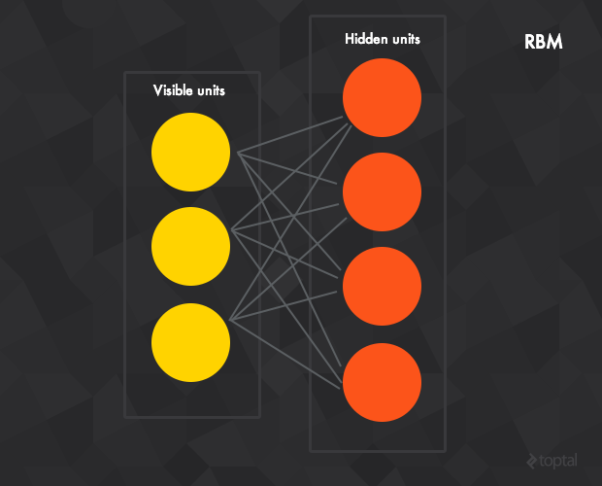
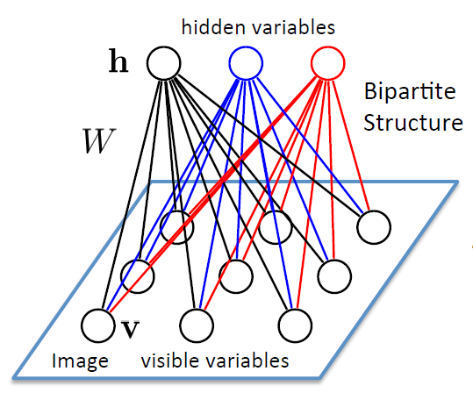
Restricted Boltzmann Machines
The next logical step is to look at a Restricted Boltzmann machines (RBM), a generative stochastic neural network that can learn a probability distribution over its set of inputs.

Slide 47
RBMs are composed of two layers, a hidden layer and a visible layer.
Unlike the feedforward networks, the connections between the visible and hidden layers are undirected (the values can be propagated in both the visible-to-hidden and hidden-to-visible directions) and fully connected.
If any unit has connections with the units in its same layer, then the network is called a Boltzmann Machine (rather than a Restricted Boltzmann Machine) .
The standard RBM has binary hidden and visible units: that is, the unit activation is 0 or 1 under a Bernoulli distribution, but there are variants with other non-linearities.

Slide 48
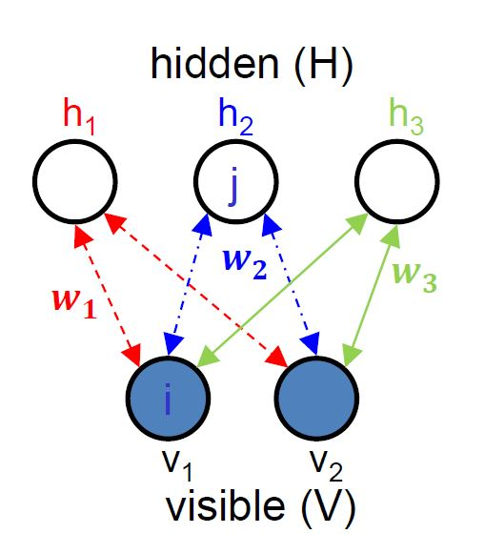
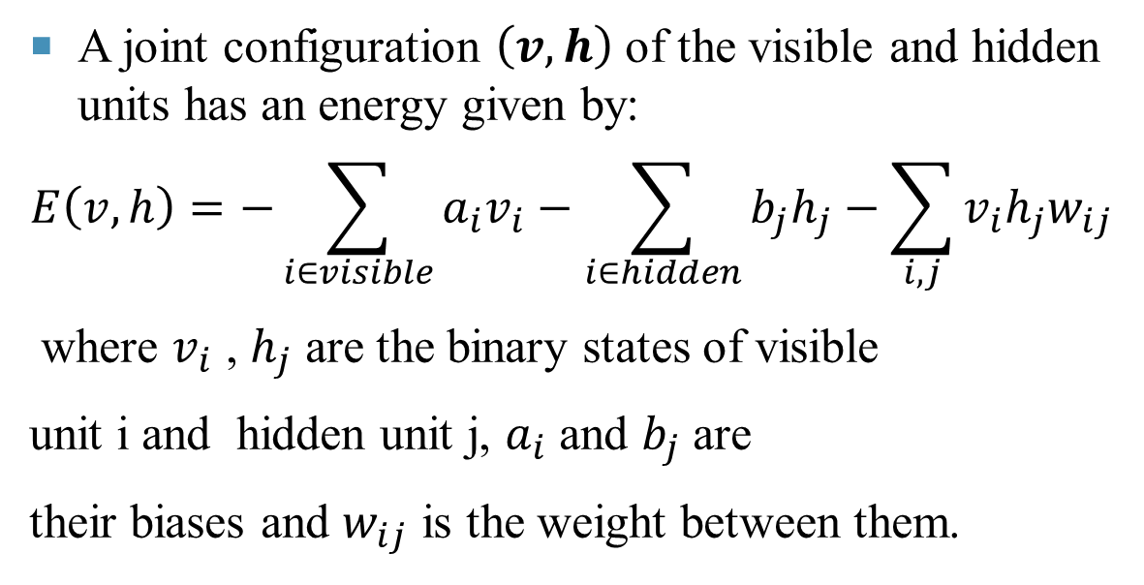
Energy of RBMs
A joint configuration $\left(v,h\right)$ of the visible and hidden units has an energy given by:
$$E\left(v,h\right)=−\sum_{i∈visible}{a_{i}v_{i}}−\sum_{i∈hidden}{b_{j}h_{j}}−\sum_{i,j}{v_{i}h_{j}w_{ij}}$$
where $v_{i}$ , $h_{j}$ are the binary states of visible
unit i and hidden unit j, $a_{i}$ and $b_{j}$are
their biases and $w_{ij}$ is the weight between them.

Slide 49
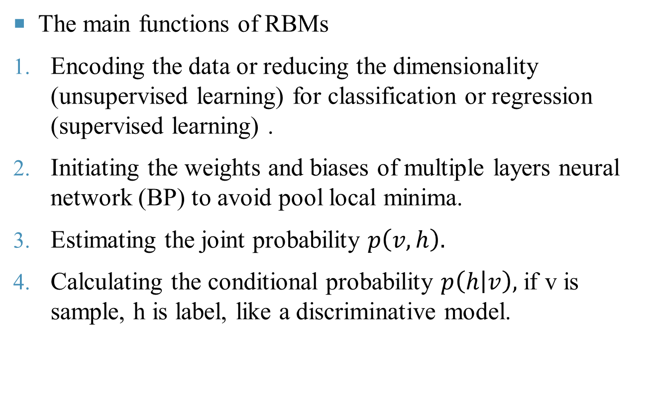
The main functions of RBMs
Encoding the data or reducing the dimensionality (unsupervised learning) for classification or regression (supervised learning) .
Initiating the weights and biases of multiple layers neural network (BP) to avoid pool local minima.
Estimating the joint probability $p\left(v, h\right).$
Calculating the conditional probability $p\left(h | v\right),$ if v is sample, h is label, like a discriminative model.

Slide 50
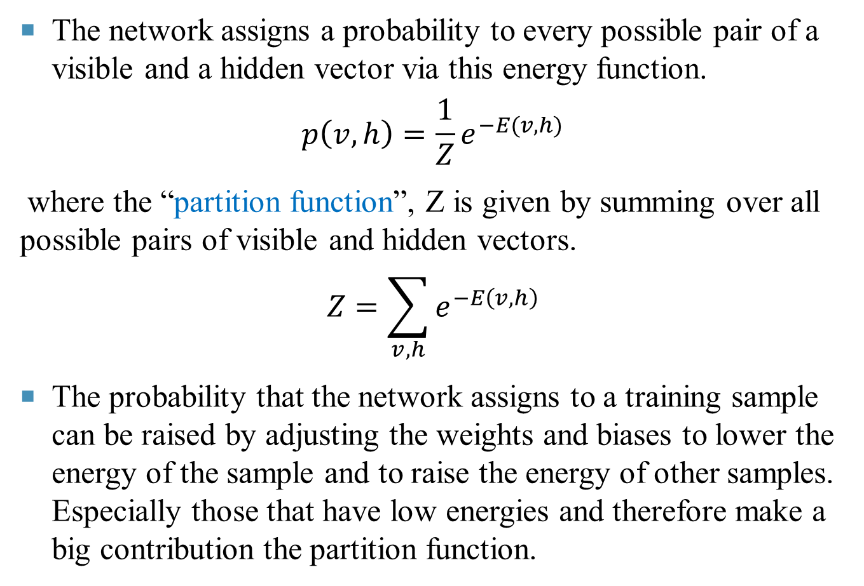
The network assigns a probability to every possible pair of a visible and a hidden vector via this energy function.
$$p\left(v,h\right)=\frac{1}{Z}e^{−E(v,h)}$$
where the “partition function”, Z is given by summing over all possible pairs of visible and hidden vectors.
$$Z=\sum_{v,h}{e^{−E\left(v,h\right)}}$$
The probability that the network assigns to a training sample can be raised by adjusting the weights and biases to lower the energy of the sample and to raise the energy of other samples. Especially those that have low energies and therefore make a big contribution the partition function.

Slide 51
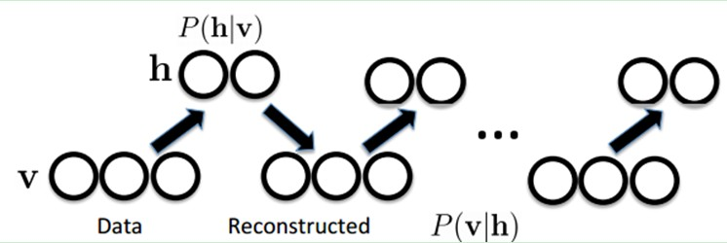
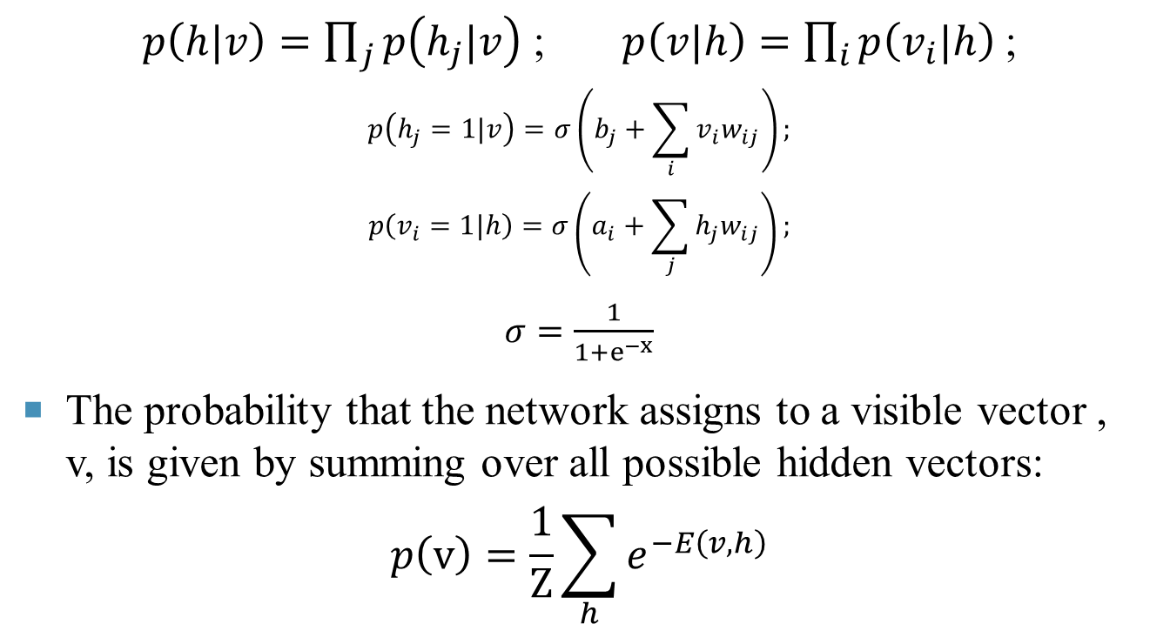
$p\left(h|v\right)=\prod_{j}{p\left(h_{j}|v\right)}$ ; $p\left(v|h\right)=\prod_{i}{p\left(v_{i}|h\right)}$ ;
$$p\left(h_{j}=1|v\right)=σ\left(b_{j}+\sum_{i}{v_{i}w_{ij}}\right);$$
$$p\left(v_{i}=1|h\right)=σ\left(a_{i}+\sum_{j}{h_{j}w_{ij}}\right);$$
$σ=\frac{1}{1+e^{−x}}$
The probability that the network assigns to a visible vector , v, is given by summing over all possible hidden vectors:
$$p\left(v\right)=\frac{1}{Z}\sum_{h}{e^{−E\left(v,h\right)}}$$

Slide 52
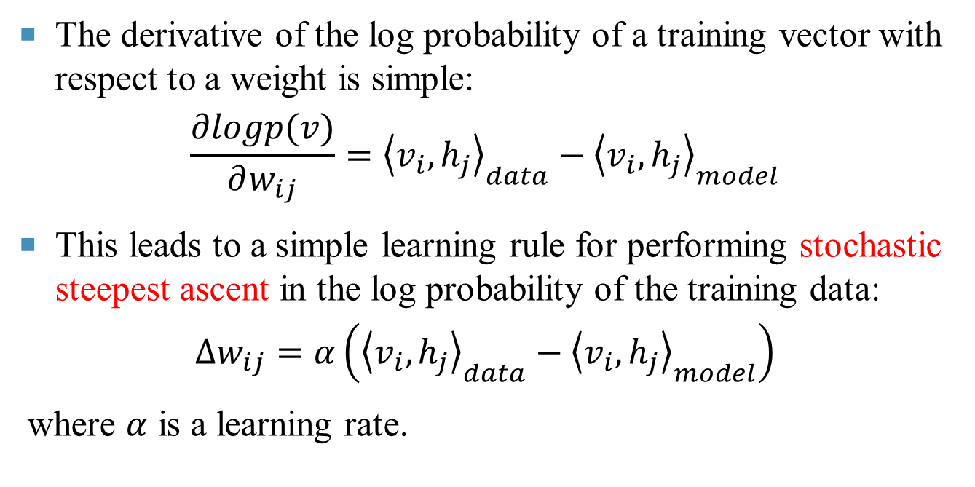
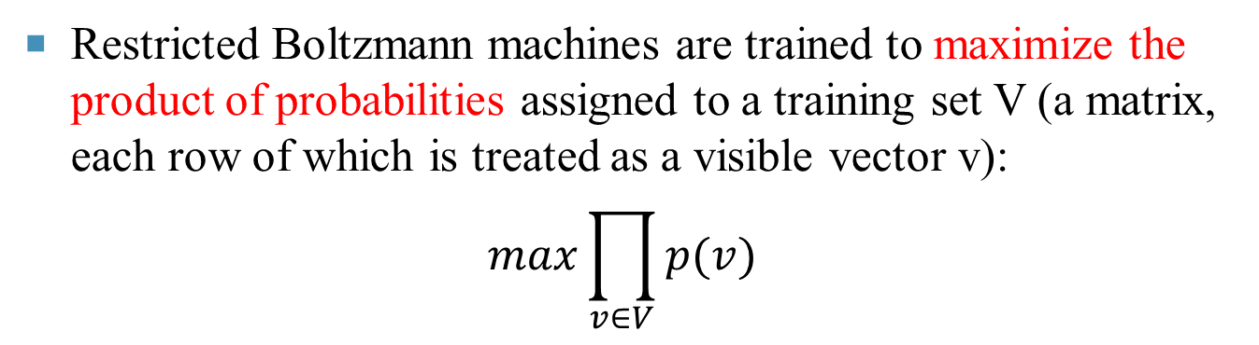
Restricted Boltzmann machines are trained to maximize the product of probabilities assigned to a training set V (a matrix, each row of which is treated as a visible vector v):
$$max\prod_{v∈V}{p(v)}$$
The derivative of the log probability of a training vector with respect to a weight is simple:
$$\frac{∂logp(v)}{∂w_{ij}}={\left\langle v_{i},h_{j}\right\rangle }_{data}−{\left\langle v_{i},h_{j}\right\rangle }_{model}$$
This leads to a simple learning rule for performing stochastic steepest ascent in the log probability of the training data:
$$∆w_{ij}=α\left({\left\langle v_{i},h_{j}\right\rangle }_{data}−{\left\langle v_{i},h_{j}\right\rangle }_{model}\right)$$
where $α$ is a learning rate.

Slide 53
Contrastive Divergence
While researchers have known about RBMs for some time now, the recent introduction of the contrastive divergence unsupervised training algorithm has renewed interest.
The single-step contrastive divergence algorithm (CD-1) works like this:
1. Positive phase:
  An input sample v is clamped to the input layer.
  v is propagated to the hidden layer in a similar manner to the feedforward networks. The result of the hidden layer activations is h.

Slide 54
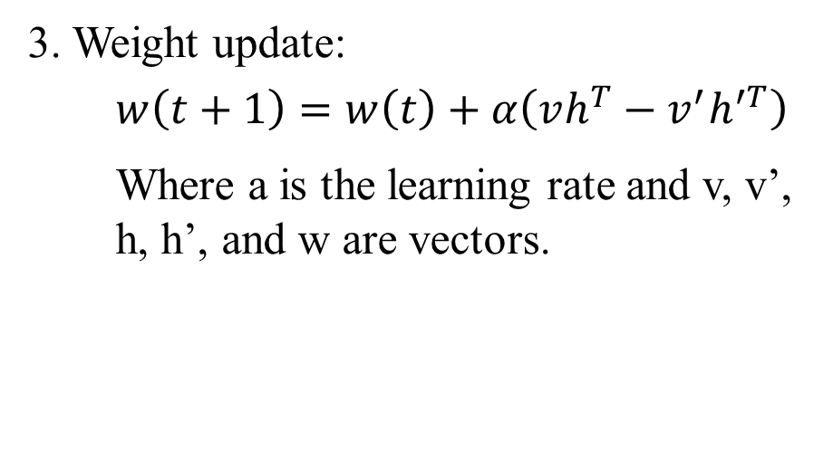
2. Negative phase:
  Propagate h back to the visible layer with result v’ (the connections between the visible and hidden layers are undirected and thus allow movement in both directions).
  Propagate the new v’ back to the hidden layer with activations result h’.
3. Weight update:
    $$w\left(t+1\right)=w\left(t\right)+α\left(vh^{T}−v^{′}h^{′T}\right)$$
    Where a is the learning rate and v, v’, h, h’, and w are vectors.

Slide 55
The Differing Goals of RBM and Autoencoders
Unlike an autoencoder, the aim of the pretraining algorithm is not to accurately reconstruct each training image but to make the distribution of the confabulations be the same as the distribution of the samples.
This goal can be satisfied even if a sample A that occurs with probability p(A) in the training set is confabulated as a sample B with probability p(B|A) provided that, for all A, p(A) = ΣB p(B) p(A|B).

Slide 56
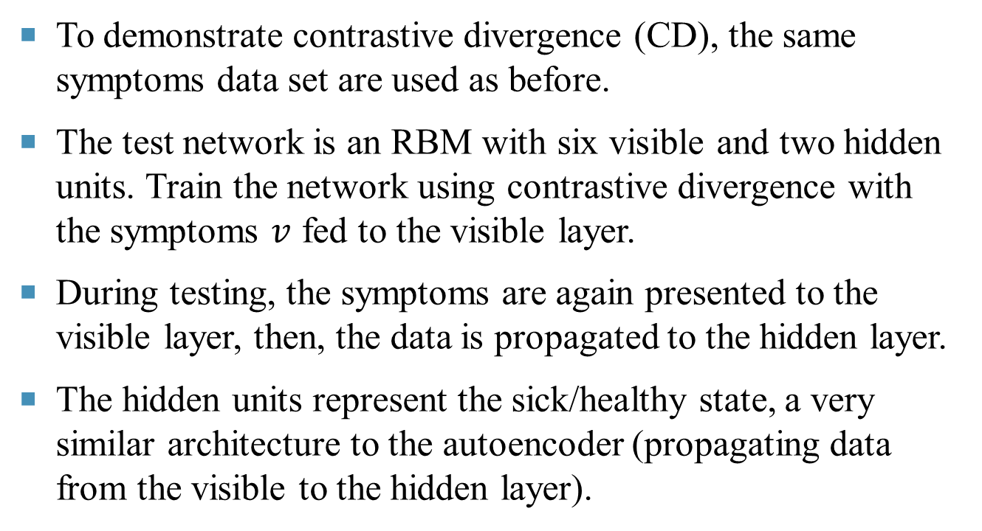
Returning to the Flu
To demonstrate contrastive divergence (CD), the same symptoms data set are used as before.
The test network is an RBM with six visible and two hidden units. Train the network using contrastive divergence with the symptoms $v$ fed to the visible layer.
During testing, the symptoms are again presented to the visible layer, then, the data is propagated to the hidden layer.
The hidden units represent the sick/healthy state, a very similar architecture to the autoencoder (propagating data from the visible to the hidden layer).

Slide 57
After several hundred iterations, we can observe the same result as with autoencoders: one of the hidden units has a higher activation value when any of the “sick” samples is presented, while the other is always more active for the “healthy” samples.
You can see this example in action in the testContrastiveDivergence method.

Slide 58
Going Back to Machine Learning
Essentially, the two hidden units have learned a compact representation of the flu symptom data set. To see how this relates to learning, return to the problem of overfitting.
By training the network to learn a compact representation of the data, a simpler representation are preferred rather than a highly complex hypothesis that overfits the training data.
In a way, by favouring these simpler representations, the model is attempting to learn the data in a truer sense.

Slide 59
Deep Networks
The hidden layers of autoencoders and RBMs act as effective feature detectors; but these features could not be used directly.
Luckily, it was discovered that these structures (Autoencoders and RBMs ) can be stacked to form deep networks.
These networks can be trained, one layer at a time to help to overcome the vanishing gradient and overfitting problems associated with classic backpropagation.
The resulting structures are often quite powerful, producing impressive results.

Slide 60
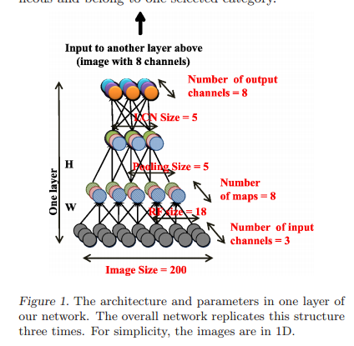
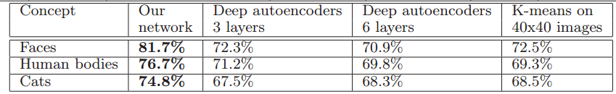
For example, Google’s famous “cat” paper in which they use special kind of deep autoencoders to “learn” human and cat face detection based on unlabeled data.

Slide 61
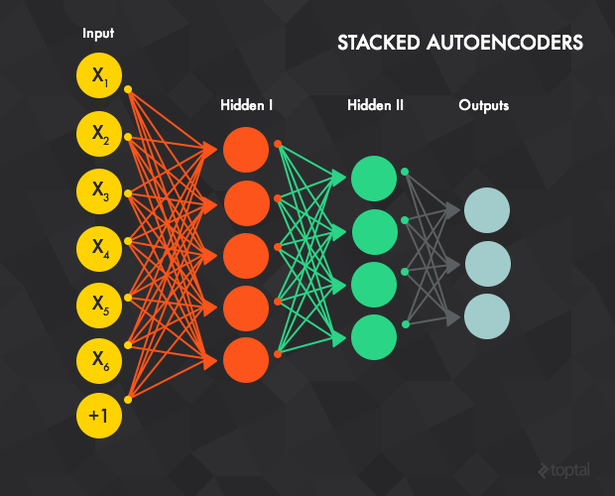
Deep Autoencoder Network
If the simple autoencoders are stacked together, they forms a deep autoencoder.
The hidden layer of autoencoder t acts as an input layer to autoencoder t + 1. The input layer of the first autoencoder is the input layer for the whole network.

Slide 62
The greedy layer-wise training procedure works like this:
Train the first autoencoder (t=1, or the red connections in the figure above, but with an additional output layer) individually using the backpropagation or gradient descent method with all available training data.
an additional output layer

Slide 63
Train the second autoencoder t=2 (green connections). Since the input layer for t=2 is the hidden layer of t=1, the output layer of t=1 are removed from the network. Training begins by feeding an input sample to the input layer of t=1, which is propagated forward to the output layer of t=2. Next, the weights (input-hidden and hidden-output) of t=2 are updated by all the training samples, similar to t=1.

Slide 64
Repeat the previous procedure for all the layers (i.e., remove the output layer of the previous autoencoder, replace it with yet another autoencoder, and train with back propagation).
Steps 1-3 are called pre-training and leave the weights properly initialized. However, there’s no mapping between the input data and the output labels. The pre-training is an unsupervised learning stage, the training could be stop when training error stops decrease.
For example, if the network is trained to recognize images of handwritten digits it’s still not possible to map the units from the last feature detector (i.e., the hidden layer of the last autoencoder) to the digit type of the image.

Slide 65
In that case, the most common solution is to add one or more fully connected layer(s) to the last layer (blue connections).
The whole network can now be viewed as a multilayer perceptron and is trained using backpropagation (this step is also called fine-tuning).
Stacked autoencoders are all about providing an effective pre-training method for initializing the weights of a network, leaving you with a complex, multi-layer perceptron that’s ready to train (or fine-tune).

Slide 66

Deep Belief Networks
As with autoencoders, stacking Boltzmann Machines could also create a class known as deep belief networks (DBNs).

Slide 67
In this case, the hidden layer of RBM t acts as a visible layer for RBM t+1. The input layer of the first RBM is the input layer for the whole network, and the greedy layer-wise pre-training works like this:
Train the first RBM t=1 using contrastive divergence with all the training samples.
Train the second RBM t=2. Since the visible layer for t=2 is the hidden layer of t=1, training begins by feeding the input sample to the visible layer of t=1, which is propagated forward to the hidden layer of t=1. This data then serves to initiate contrastive divergence training for t=2.
Repeat the previous procedure for all the layers.

Slide 68
Similar to the deep autoencoder network, after pre-training the network can be extended by connecting one or more fully connected layers to the final RBM hidden layer. This forms a multi-layer perceptron which can then be fine tuned using backpropagation.
Remark:
  This procedure is similar to that of deep autoencoders, but with the autoencoders replaced by RBMs and gradient descent (or BP) replaced with the contrastive divergence algorithm.
  The next are some examples of autoencoders.

Slide 69

MNIST DataVisualization
The MNIST database of handwritten digits has a training set of 60,000 examples, and a test set of 10,000 examples.
Here's a random sample of the mnist training set

Slide 70

MINST Data Visualization
A. The two dimensional codes for 500 digits of each class produced by taking the first two principal components of all 60,000 training images.
B. The two-dimensional codes found by a 784-1000-500-250-2 autoencoder.

Slide 71

MINST Data Visualization
The first layer of the deep autoencoder should have 1000 parameters; i.e. slightly larger. This may seem counterintuitive, because having more parameters than input is a good way to overfit a neural network.
A. PCA

Slide 72

MINST Data Visualization
This is due to the representational capacity of sigmoid-belief units, a form of transformation used with each layer. Sigmoid units can’t represent as much as information and variance as real-valued data. The expanded first layer is a way of compensating for that.
B. Autoencoder

Slide 73



Documents Exemples: Codes Allow Fast Retrieval
Sample: 804,414 news stories.
A. The fraction of retrieved documents in the same class as the query when a query document from the test set is used to retrieve other test set documents, averaged over all 402,207 possible queries.
B. The codes produced by two-dimensional LSA (latent semantic analysis).
C. The codes produced by a 2000-500-250-125-2 autoencoder

Slide 74

Compressing the Input: Grayscale Images
Deep Autoencoder Network
The Training Process:
Step 1: pretraining;
Step 2: unrolling;
Step 3: fine-tuning.

Slide 75

Convolutional Neural Networks
As a final deep learning architecture, let’s take a look at convolutional neural networks (CNN), a particularly interesting and special class of feedforward networks that are very well-suited to image recognition.
LeNet Image via DeepLearning.net

Slide 76
Motivation of CNN
Convolutional Neural Networks (CNN) are biologically-inspired variants of MLPs.
The visual cortex contains a complex arrangement of cells. These cells are sensitive to small sub-regions of the visual field, called a receptive field.
The sub-regions are tiled to cover the entire visual field. These cells act as local filters over the input space and are well-suited to exploit the strong spatially local correlation present in natural images.

Slide 77

Additionally, two basic cell types have been identified: Simple cells respond maximally to specific edge-like patterns within their receptive field.
Complex cells have larger receptive fields and are locally invariant to the exact position of the pattern.
The animal visual cortex being the most powerful visual processing system in existence, it seems natural to emulate its behaviour.

Slide 78
Image Filter
Before we look at the actual structure of convolutional networks, we first define an image filter, or a square region with associated weights.
A filter is applied across an entire input image, and you will often apply multiple filters.
For example, you could apply four 6x6 filters to a given input image. Then, the output pixel with coordinates (1,1) is the weighted sum of a 6x6 square of input pixels with top left corner (1,1) and the weights of the filter (which is also 6x6 square). Output pixel (2,1) is the result of input square with top left corner (2,1) and so on.

Slide 79

With that covered, these networks are defined by the following properties:
Convolutional layers apply a number of filters to the input. For example, the first convolutional layer of the image could have four 6x6 filters. The result of one filter applied across the image is called feature map (FM) and the number of feature maps is equal to the number of filters.

Slide 80
If the previous layer is also convolutional, the filters are applied across all of it’s FMs with different weights, so each input FM is connected to each output FM. The intuition behind the shared weights across the image is that the features will be detected regardless of their location, while the multiplicity of filters allows each of them to detect different set of features.
Subsampling layers reduce the size of the input. For example, if the input consists of a 32x32 image and the layer has a subsampling region of 2x2, the output value would be a 16x16 image, which means that 4 pixels (each 2x2 square) of the input image are combined into a single output pixel. There are multiple ways to subsample, but the most popular are max pooling, average pooling, and stochastic pooling.

Slide 81

The last subsampling (or convolutional) layer is usually connected to one or more fully connected layers, the last of which represents the target data.
Training is performed using modified backpropagation that takes the subsampling layers into account and updates the convolutional filter weights based on all values to which that filter is applied.

Slide 82

Image Recognition Example 1
The figure comes from http://cs231n.github.io/convolutional-networks/

Slide 83

Image Recognition Example 2
Image from: http://code.flickr.net/

Slide 84

Image Recognition Example 3
http://arxiv.org/pdf/1409.0575.pdf

Slide 85


ImageNet
ImageNet is an image database organized according to the WordNet hierarchy (currently only the nouns), in which each node of the hierarchy is depicted by hundreds and thousands of images.

Slide 86

Fei-Fei Li: How we're teaching computers to understand pictures

Slide 87
Conclusion
The aim of this deep learning tutorial was to give you a brief introduction to the field of deep learning algorithms, beginning with the most basic unit of composition (the perceptron) and progressing through various effective and popular architectures, like that of the restricted Boltzmann machine.
The ideas behind neural networks have been around for a long time; but today, you can’t step foot in the machine learning community without hearing about deep networks or some other take on deep learning.

Slide 88




Hype shouldn’t be mistaken for justification, but with the advances of GPGPU computing and the impressive progress made by some famous researchers like Geoffrey Hinton, Yoshua Bengio, Yann LeCun and Andrew Ng.
Geoffrey Hinton
Emeritus Professor at University of Toronto
Distinguished Researcher, Google.
Yoshua Bengio
Full professor at University de Montréal.
Operations Research Canada Research Chair in Statistical Learning Algorithms.
Yann LeCun
Professor at New York University.
Director of AI Research, Facebook.
Andrew Ng
A/Professor (Research) at Stanford University.
Chairman and Co-founder of Coursera.
Chief Scientist of Baidu.

Slide 89

Deep Learning at NIPS 2014 Ng in Montreal, Quebec.
Yann LeCun, Geoffrey Hinton, Yoshua Bengio, and Andrew
The field certainly shows a lot of promise. There’s no better time to get familiar and get involved like the present.
Here are some online courses, if you want to learn more:
Machine Learning, Stanford University by Andrew Ng
Neural Networks for Machine Learning by Geoffrey Hinton
You can find more information of Machine Learning and Deep Learning online now.

Slide 90
Reference
Ivan Vasilev, A Deep Learning Tutorial: From Perceptrons to Deep Networks, https://www.toptal.com/machine-learning/an-introduction-to-deep-learning-from-perceptrons-to-deep-networks.
LeCun, Y., Bengio, Y. and Hinton, G. E. (2015) Deep Learning, Nature, Vol. 521, pp 436-444.
Hinton, G. E. and Salakhutdinov, R. R. (2006) Reducing the dimensionality of data with neural networks. Science, Vol. 313. no. 5786, pp. 504 - 507, 28 July 2006.
Hinton, G. E., Osindero, S. and Teh, Y. (2006) A fast learning algorithm for deep belief nets. Neural Computation, 18, pp 1527-1554.
Hinton, G. E. (2010). A practical guide to training restricted Boltzmann machines. Momentum, 9(1), 926.

Slide 91

Question and Discussion

